Slide 1
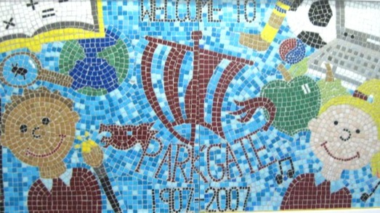

Parkgate Junior School
Headteacher Recruitment Pack

Slide 2
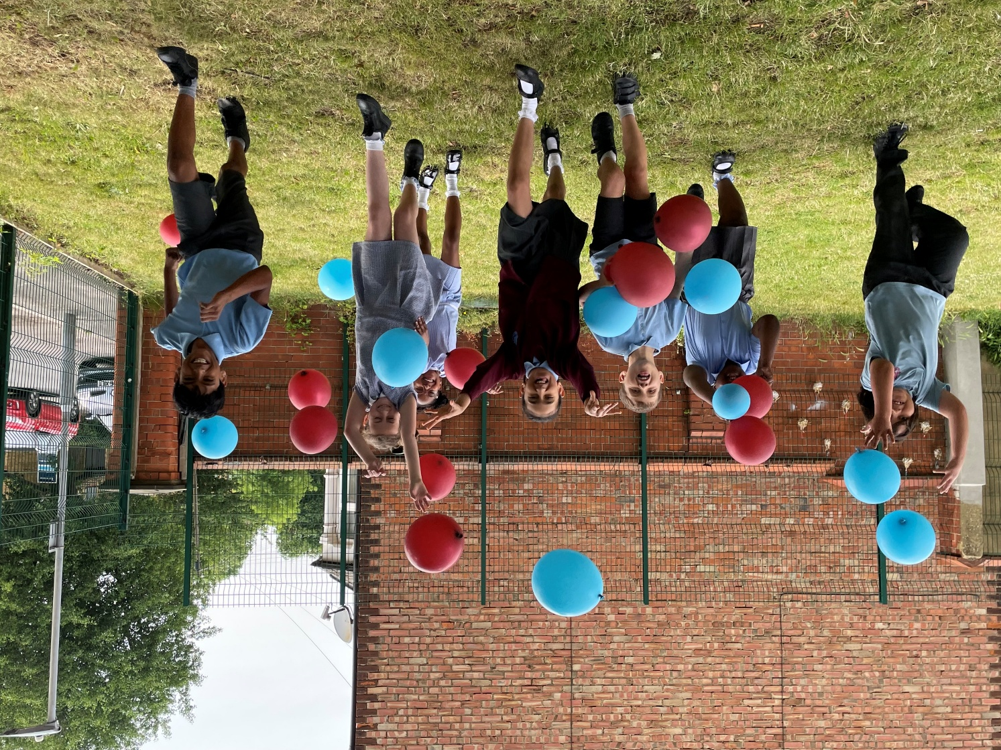

CONTENTS
Welcome from the Chair of Governors | 3
Key facts & statistics | 4
About our school | 5
Our vision & aims | 6
Our new headteacher | 7
What we can offer | 8
Person specification | 9
Job description | 11
Important information | 12
Application process | 13

Slide 3
WELCOME FROM THE CHAIR OF GOVERNORS
Dear Applicant,
Thank you for your interest in the Headteacher position at Parkgate Junior School. We are pleased to share this information pack, which we hope provides a valuable insight into our vibrant and welcoming school community, and the opportunity to make a meaningful impact.
This vacancy has arisen following the retirement of our current Headteacher, who has served the school with dedication for the past 18 years.
Parkgate Junior School is a happy dynamic community where every child is inspired through discovery and learning, to reach their full potential, in preparation for a successful future. We are proud to be recognised for the strong relationships fostered among staff, pupils, parents, and the wider community.
We are seeking a leader with the energy, drive, and passion to guide our school into its next chapter.
Key Dates and Contact Information
The closing date for applications is Thursday, 9 October 2025 at 9AM
To learn more about our school, please visit: www.parkgatejm.herts.sch.uk
Should you wish to discuss the role further, please contact our Chair of Governors, Dipesh Patel, at CoG@parkgatejm.herts.sch.uk to arrange a conversation. We warmly encourage prospective candidates to visit the school. To schedule a visit, please contact the school office at 01923 243905 or email admin@parkgatejm.herts.sch.uk.
Thank you once again for considering Parkgate Junior School. We wish you every success with your application and look forward to the possibility of welcoming you to our school.
Yours sincerely,
The Governing Body Parkgate Junior School

Slide 4



School Statistics
Two-form entry
community school
Number of Roll:
240
Age Range:
7 – 11 Years
Rated Outstanding
July 2024
15%
FSM
21%
SEND
15.5%
Pupil Premium
42%
EAL
Parkgate Junior School
Headteacher Recruitment Candidate Pack

Slide 5
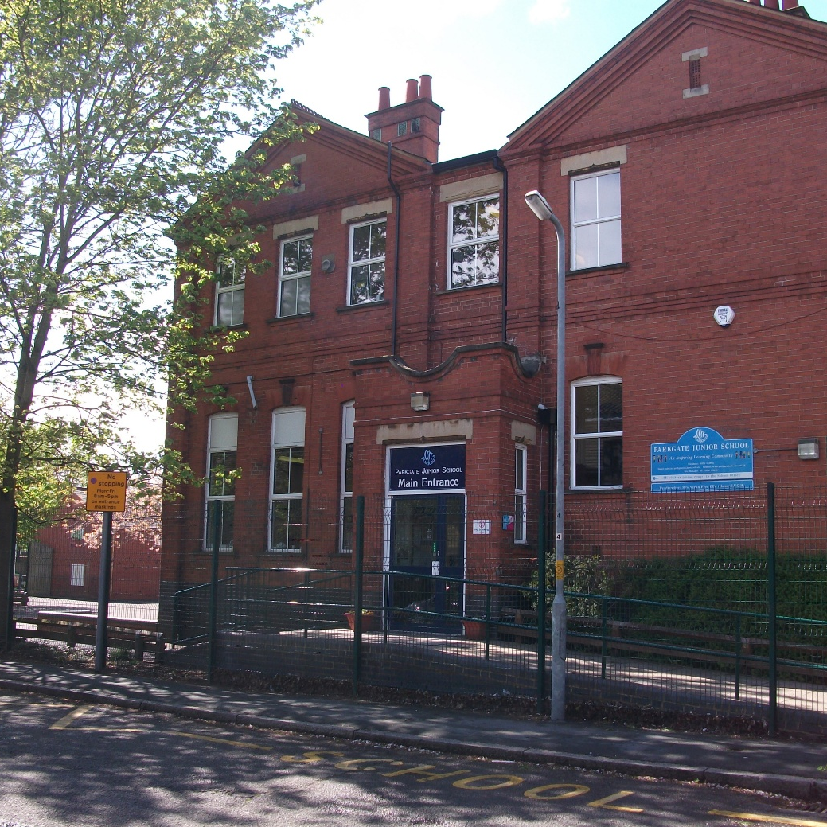

About our school
Parkgate Junior School is a two-form entry community school located in North Watford, Hertfordshire, welcoming children aged 7 to 11. Housed in a characterful Edwardian building, the school blends historic charm with modern learning.
Classrooms are bright and well-equipped, with dedicated spaces for music, computing, and small group work. Every pupil has access to a Chromebook, and our hybrid approach to teaching combines traditional methods with digital tools to support engagement and prepare children for the future.
Parkgate is a richly diverse school, with over 30 languages spoken. We are an accredited International School and celebrate our global community through events such as International Week, food festivals, and Mother Tongue Day. These experiences help pupils develop confidence, curiosity, and a sense of belonging.
We also place a strong emphasis on healthy living and wellbeing. The school holds Healthy Schools status and is part of the local Schools Sports Partnership. Our commitment to physical activity is reflected in the wide range of sports clubs on offer - from Karate to Street Dance, Golf to Basketball - and our achievement of the Active Mark.
We are proud of our inclusive ethos and commitment to meeting the needs of all learners. Staff work collaboratively to provide personalised support, especially for pupils with complex needs, and the school continues to adapt creatively to ensure every child can thrive. There is a clear focus on staffing and resources that reflect our priorities and values.
At the heart of Parkgate is a strong sense of family. Staff, pupils, and families work together to create a warm, supportive environment where relationships matter, and every child is known and valued. The “Parkgate Family” ethos runs through everything we do - creating a school full of heart, ambition, and purpose.

Slide 6
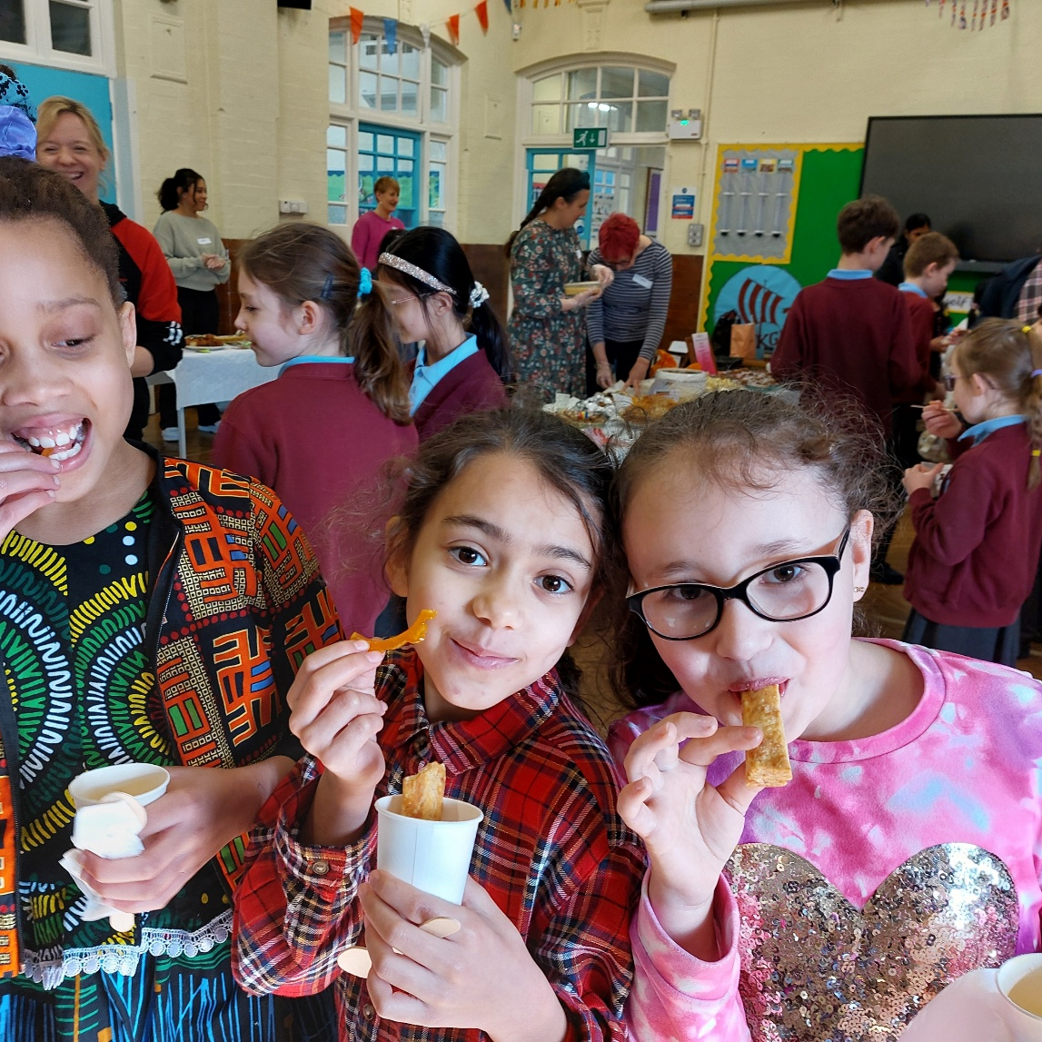
OUR VISION & aims
Our
School Motto
We learn together
We help each other
We respect each other
We try hard every day to
become the best we can be
Not for self, but for all
Parkgate Juniors is special because we all have something
amazing to contribute to the Parkgate family.

Slide 7
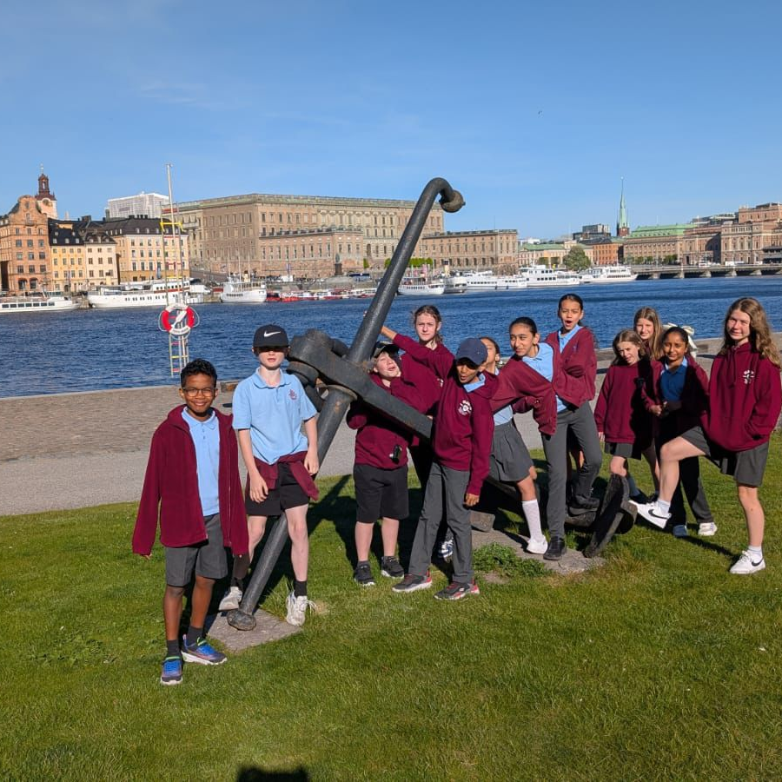
OUR NEW HEADTEACHER will:
Be a highly visible and approachable leader who builds strong relationships across the school community.
Be emotionally intelligent, fostering trust through openness, empathy, and proactive communication.
Actively engage in the life of the school, with a hands-on approach to supporting pupils, staff, and families.
Empower staff by promoting autonomy, collaboration, and professional respect.
Lead a responsive, child-centred curriculum that responds to all learners’ needs.
Demonstrate confident and effective leadership in behaviour management across the school.
Be experienced in inclusive practice and committed to supporting pupils with additional needs.
Bring energy, resilience, and consistency to lead a busy and diverse school environment.
Work collaboratively with SLT and governors to drive strategic improvement.
Offer fresh vision and innovation while respecting and building on the school’s strong foundations.

Slide 8
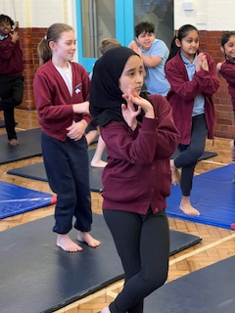
WHAT WE CAN OFFER
A warm, inclusive school community with a strong family ethos.
A committed and empowered staff team who value autonomy and collaboration.
A supportive senior leadership team working closely and cohesively.
A culture of innovation where new ideas are welcomed and supported.
Strong relationships with families built on openness and proactive engagement.
A well-established digital learning environment with 1:1 Chromebook access.
A diverse pupil population supported through inclusive and SEN-focused provision.
Excellent facilities including a basketball court, outdoor gym, and dance stage.
A supportive and engaged governing body committed to the school’s continued success.
A proud legacy of strong leadership.

Slide 9
Person Specification
To be considered for shortlisting, candidates must clearly demonstrate how they meet the essential - and where possible, the desirable - criteria outlined in the Person Specification below.
Please structure your supporting statement using the STAR format (Situation, Task, Action, Result) to provide clear, evidence-based examples of your experience and impact.
If shortlisted, we will assess additional aspects of school leadership - including alignment with the Headteacher Standards (2020) and the specific needs of our school - through a series of tasks and a formal interview during the assessment day.
Qualifications, knowledge and experience
Degree and qualified teacher status (E)
Recent successful leadership experience as a Headteacher, Deputy headteacher, Assistant headteacher or School Improvement Lead (E)
NPQH or equivalent leadership development experience (e.g. coaching, mentoring, strategic leadership programmes) (D)
Strategic Leadership and School improvement
Sets and sustains ambitious educational standards for ALL pupils (E)
Committed to prioritising the continued professional development of all staff (including themselves) in the best interests of the individual, the team and the school (E)
Has had active involvement in effective school self-evaluation and development planning (E)
Experience of leading change effectively and successfully (E)

Slide 10
Person Specification
Teaching, learning & curriculum
Deep understanding of high-quality teaching and learning across the primary phase (E)
Absolute commitment to inclusion and to ambitious expectations for all pupils including disadvantaged pupils, those with SEND and higher attainers (E)
Knowledge and experience of working with children with SEND across the primary phase (E)
Able to understand the needs of children with challenging behaviours and develop strategies to successfully manage this (E)
Experience of supporting, guiding and managing staff to deliver effective outcomes (E)
Working in partnership/Governance & accountability
Experience of working with stakeholders including governors, school improvement partners, other schools and organisations to improve outcomes for pupils (E)
Experience of managing school finances effectively, understanding their contribution to school development and pupil outcomes (D)
Demonstrates integrity, openness, and courage in communication with governors and stakeholders, fostering trust through honest and transparent dialogue - even when delivering difficult messages (E)
Personal Qualities/ Ethics and professional conduct
Visible and approachable, empathetic and enjoys engaging the whole school community (E)
Actively promotes an inclusive school culture that celebrates diversity, ensuring that all pupils, staff, and families feel seen, valued, and respected (E)
Adaptable leadership style, ‘hands on’ when required, balanced with knowing when to delegate (E)
Demonstrates consistently high standards of principled and professional conduct both within and outside school, Seven Principles of Public Life (E)

Slide 11
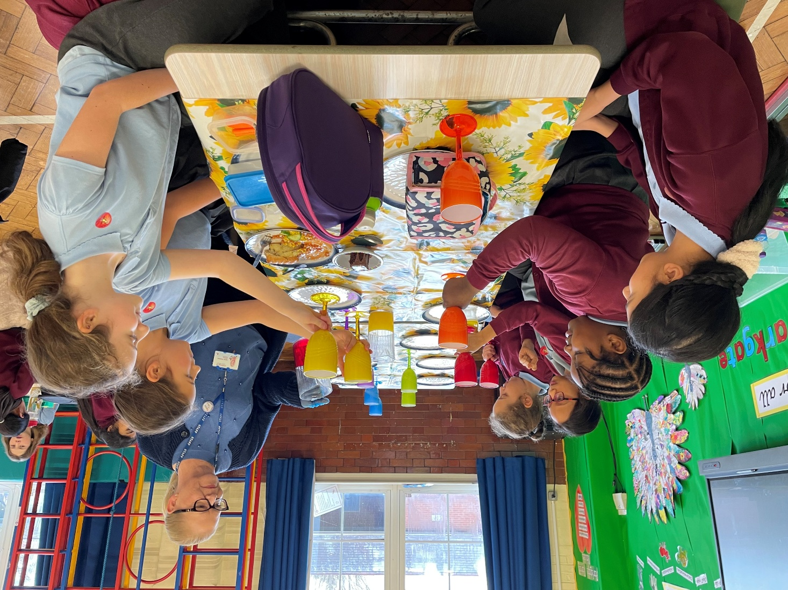

JOB description
The headteacher provides strategic and operational leadership to ensure the school’s success, continuous improvement, and the delivery of high-quality education for all pupils, in line with statutory requirements.
To gain this success, the headteacher must:
Demonstrate consistently high standards of principled and professional conduct both within and outside school.
Uphold fundamental British values, including democracy, the rule of law, individual liberty and mutual respect, and tolerance of those with different faiths and beliefs.
Always serve in the best interests of the school’s pupils.
Establish high quality education by effectively managing teaching and learning to realise the potential of all pupils.
Develop and communicate a compelling vision to lead the school into its next phase of growth and improvement.
Develop a strategy with our community and other schools to provide clear educational pathways for our pupils as they grow older.
Lead the school’s strategic planning to ensure sustainable growth, financial stability, and long-term success.
Appointment is subject to the current conditions of employment of headteachers, contained in the School Teachers’ Pay and Conditions document, the School Standards and Framework Act 1998 and all other current education, employment and health and safety legislation.
Headteachers’ Standards (2020)
These non-statutory standards provide a nationally recognised benchmark for excellent leadership. They are widely used to support recruitment, professional development, and performance management. You can view the standards here – Headteachers’ Standards

Slide 12
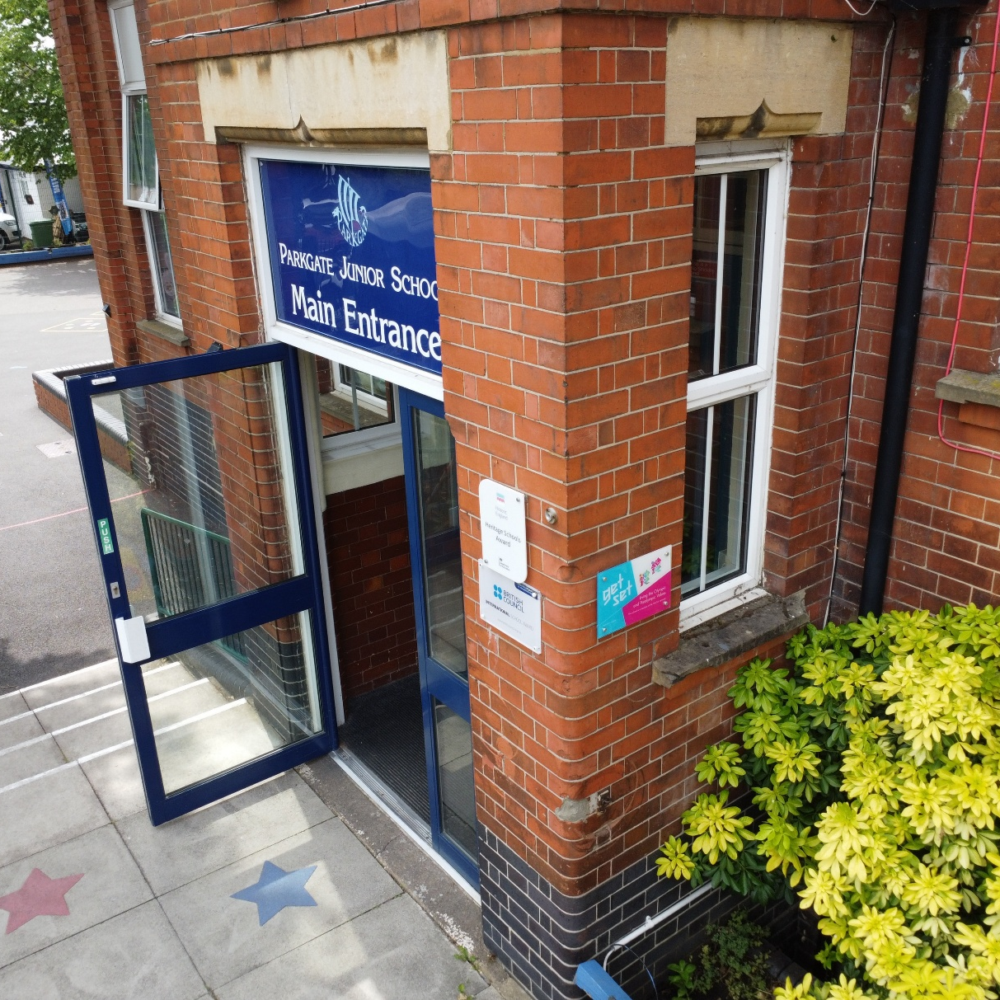
IMPORTANT INFORMATION
Pay range: | L10 – L18 Fringe, £63,576 - £77,051
Start date: | January 2026
Closing date: | Thursday 9th October 2025 at 9AM
Shortlisting date: | Thursday 16th October 2025
Interview date: | Thursday 23rd October 2025
Visits to the school: | To discuss the role further, please contact our Chair of Governors, Dipesh Patel, at CoG@parkgatejm.herts.sch.uk to arrange a conversation. To schedule a visit, please contact the school office at 01923 243905 or email admin@parkgatejm.herts.sch.uk
School website: | www.parkgatejm.herts.sch.uk
School address: | Southwold Road, Watford, WD24 7DN
Parkgate Junior School is committed to safeguarding and promoting the welfare of children and young people and expects all staff and volunteers to share this commitment. Appointment to this post is subject to an enhanced Disclosure and Barring Service check as well as other pre-appointment checks, including an online check, as outlined in Keeping Children Safe in Education (September 2024).
To help us continue to meet our aspirations of a fully diverse and inclusive workplace, we welcome applications from all suitably qualified individuals regardless of age, gender, ethnicity or religion.

Slide 13
APPLICATION PROCESS

Slide 14
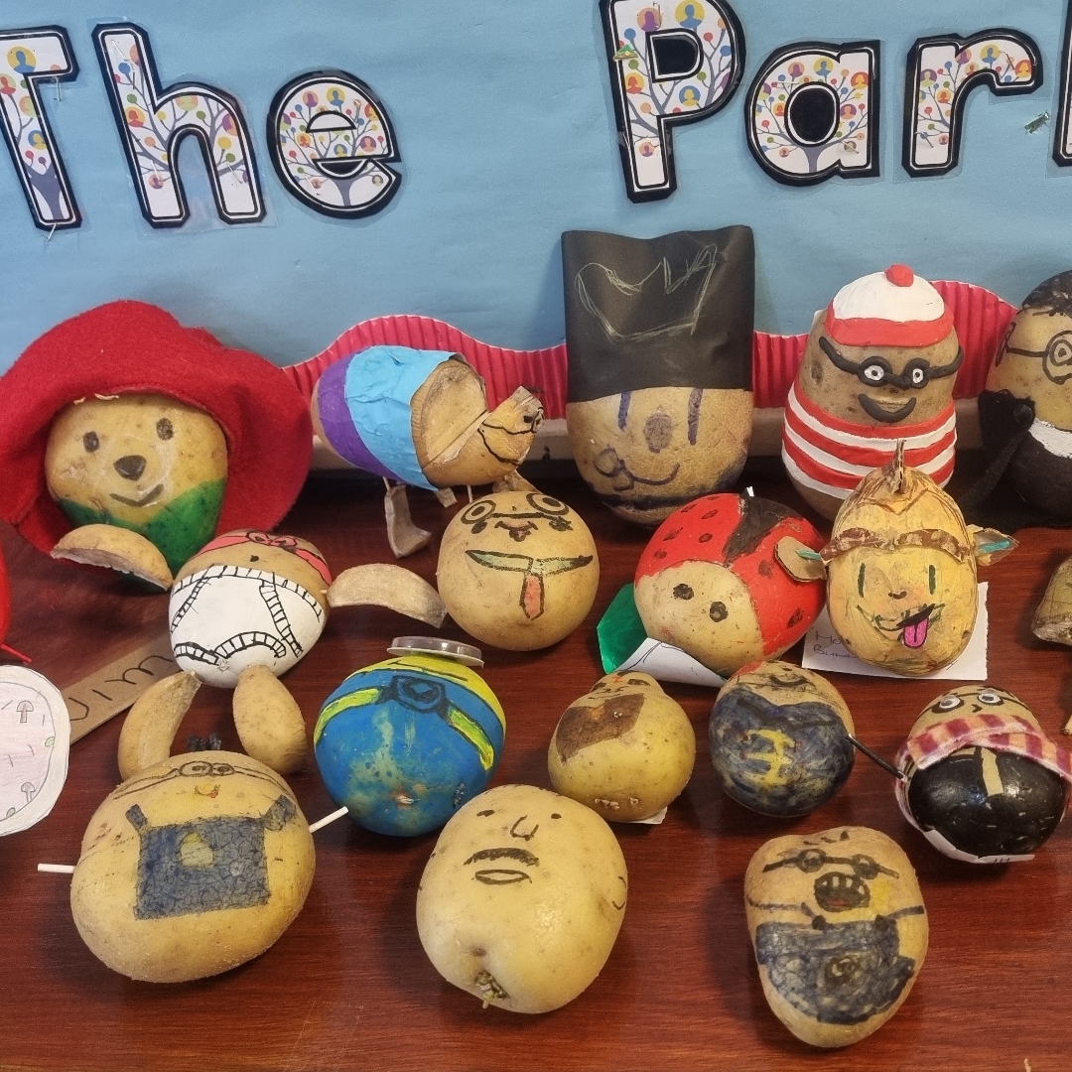
Parkgate junior school
Southwold Road, Watford, WD24 7DN
01923 243905 | admin@parkgatejm.herts.sch.uk
Parkgate Junior School
Headteacher Recruitment Candidate Pack

