Slide 1

Weston Way Nursery School
Inclusion Early Years
Practitioner
Recruitment Pack
‘Home from Home’

Slide 2
‘Home from Home’, where as a family, we play, learn and grow in our journey together, shaping the future.
“
2
”
Our Vision
2
‘Home from Home’

Slide 3
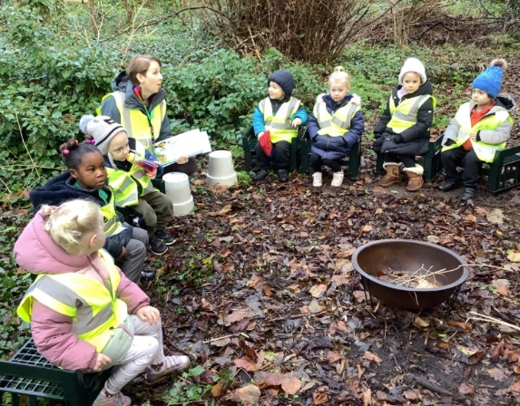
CONTENTS
Headteacher welcome | 4
About our nursery school | 5
Information for candidates | 6
What we offer | 7
Safeguarding | 8
Job description | 9 – 11
Person specification | 12 - 14
Thank you | 15
Website | 16
‘Home from Home’

Slide 4
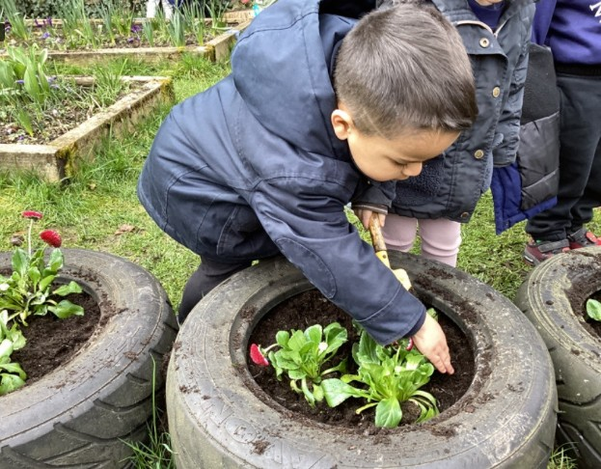
HEADTEACHER WELCOME
Dear Applicant,
A warm welcome from me and everyone else involved in the life at Weston Way Nursery School.
Our nursery is at the heart of the Baldock community since 1942. We have a strong vision rooted in our ‘Home from Home’ ethos, whereby we offer quality early years provision for 2-5 year olds from 8.00am-5.00pm Monday to Thursday and 8.00am-4.00pm on a Friday. During this time, the children have the opportunity to play and grow in our extensive grounds surrounded by the most magical woodland which enables us to fulfil our aims:
Happiness / Opportunity / Magical Moments / Engagement.
Our inspiring practitioners at Weston Way Nursery School strive to ensure the needs of every child are met through our well thought-out curriculum that is unique to us. We value our partnerships which enable us to build relationships as we seek to offer each child the best start in life.
At Weston Way Nursery School, the Inclusion Early Years Practitioner plays a vital role in supporting children, families and staff as part of our dedicated team, a role we highly value. Our Inclusion Early Years Practitioner will understand the importance of promoting equity, inclusion and positive outcomes for all children, particularly those with SEND, speech and language needs, or social and emotional needs. Through the responsibilities outlined in the job description, you will help ensure every child can access a nurturing, ambitious and inclusive curriculum. You will support safeguarding and children's wellbeing, working closely with colleagues, families and external professionals. We work together as a team and there is always someone on hand to help. We have built a culture where no question is a silly question and we seek solutions together. Each day brings new opportunities and challenges, and we respond flexibly to meet the changing needs of our nursery community.
We are looking for someone who is highly organised and able to prioritise their workload effectively whilst overseeing inclusive practice across the nursery, including our wraparound care provision. You will work closely with staff, families and external professionals to ensure that all children, particularly those with additional needs, can access high-quality, inclusive experiences throughout the day. We believe in the professional development of staff and invest in training, networks and partnership working opportunities that support this role and promote best practice in inclusion.
Our website provides an overview of everything we offer but please visit us to feel our warm and nurturing environment for yourself. Please contact me to discuss the role on 01462 892172 or email head@westonway.herts.sch.uk
Thank you for your interest in this role at Weston Way Nursery School.
Our team of co-adventurers look forward to meeting you.
Warm Regards,
Kelly Nichol
Headteacher Co-adventurer
‘Home from Home’

Slide 5

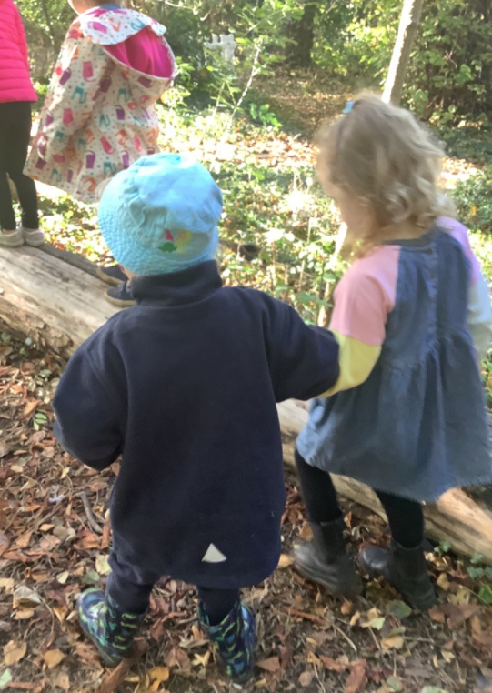
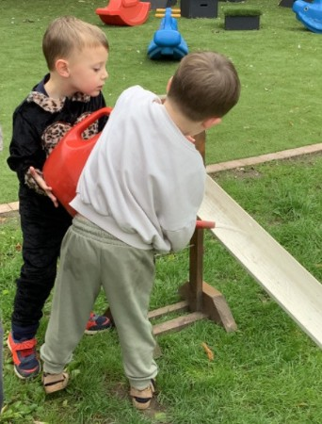

ABOUT OUR NURSERY SCHOOL
Baldock
ON ROLL
75
children
SEND
4%
Age 2-5 years
March 2024
EY Pupil Premium
13%
EAL
8%
‘Home from Home’

Slide 6
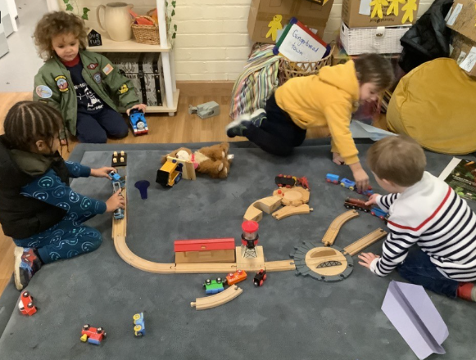
INFORMATION FOR CANDIDATES
“The staff are incredibly supportive of my child. They also picked up on some struggles we are having at home and offered their support to us.”(Nursery Parent)
Information | Detail
Pay range | H5 (£28,153- £30,515 FTE)
Start date | 4 January 2027
Closing date | Wednesday 4 November 2026 - midday
Shortlisting | Wednesday 4 November 2026
Interview date | TBC
Visits to School | 01462 892172 / head@westonway.herts.sch.uk
School website | www.westonway.herts.sch.uk
School Address | Weston Way, Baldock, Hertfordshire, SG7 6HD
‘Home from Home’

Slide 7
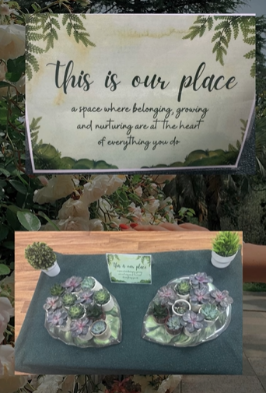
WHAT WE OFFER
At Weston Way Nursery School, our vision embodies everything we do. We offer a workplace that recognises the importance of building strong working relationships whereby everyone’s wellbeing is held with high importance.
We offer:
Professional development opportunities (CPD)
Access to networks
Employee Assistance programme
Access to pension scheme and sick pay
Cycle to work scheme
Wellbeing initiatives (open door, wellbeing weeks, quiet spaces)
Celebration of milestones (birthdays, long service)
Flexible approach to attend personal events such as school assemblies and sports days
Time off in school holidays
Free tea and coffee
Value staff voice
Positive, inclusive culture
‘Home from Home’

Slide 8

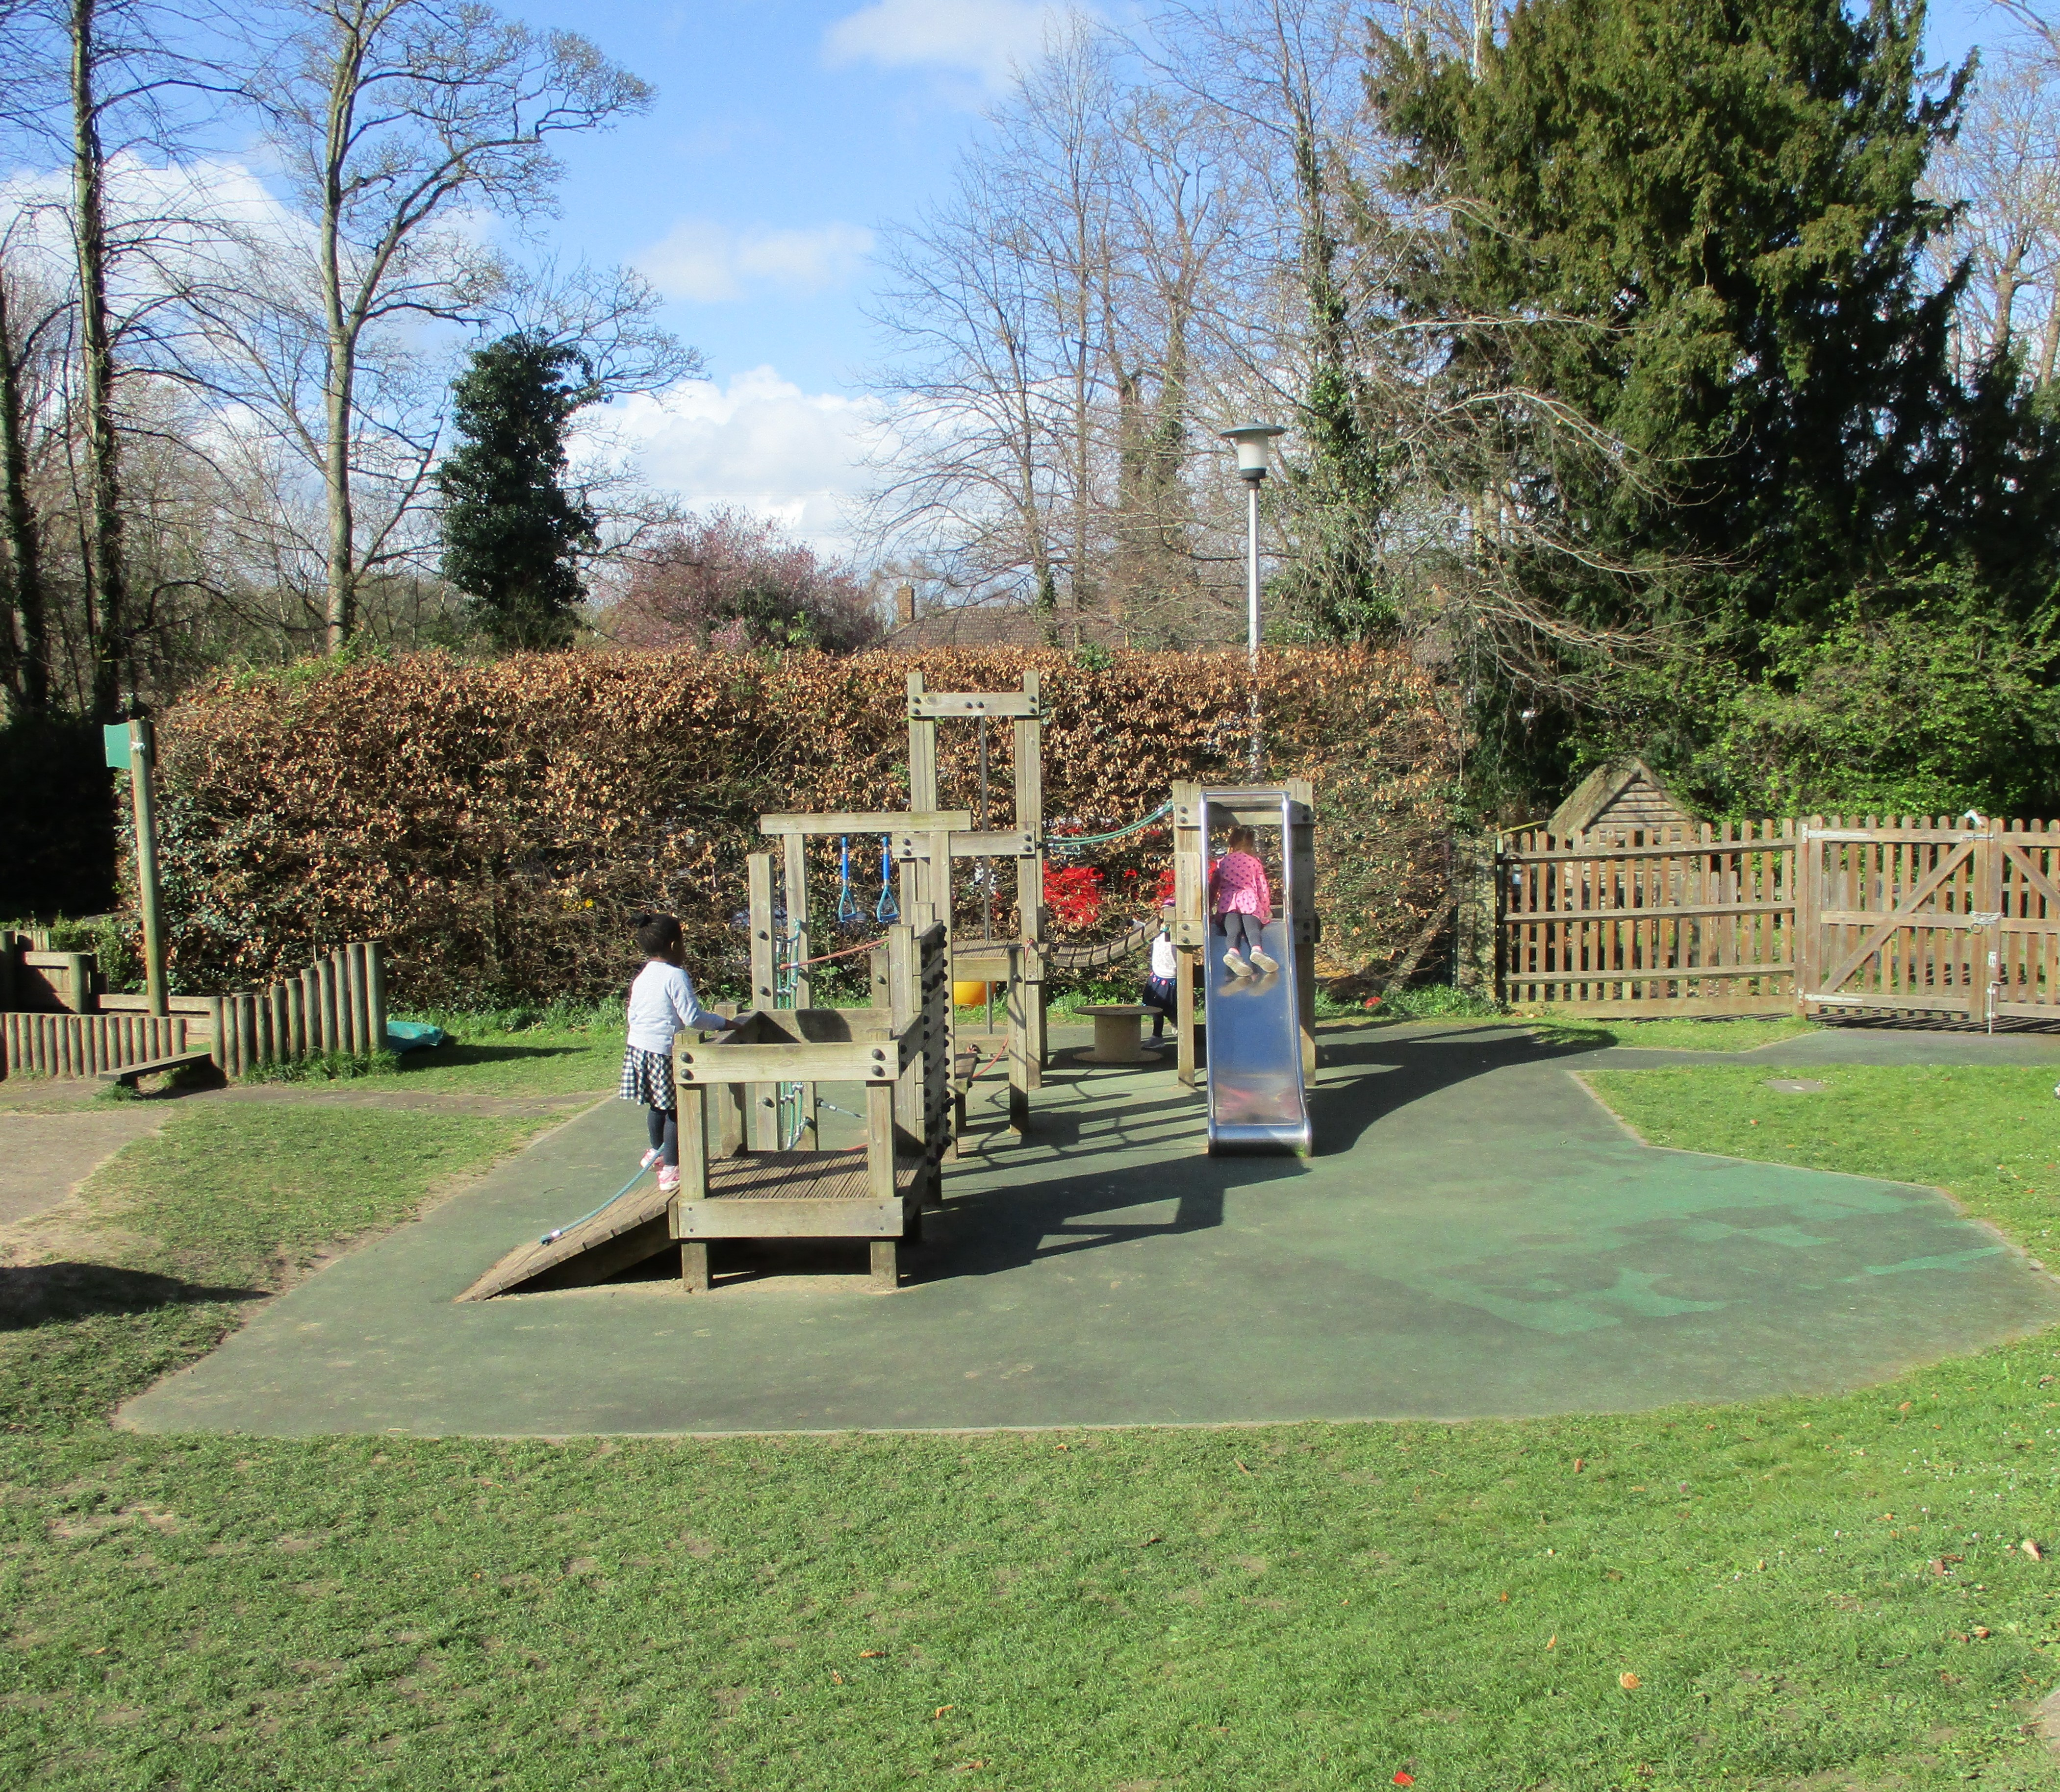
SAFEGUARDING
WWNS
Weston Way Nursery School is committed to safeguarding and promoting the welfare of children and expects all staff and visitors to share this commitment. Appointment to this post will be subject to a Disclosure and Barring Service (DBS) enhanced check, as well as other pre-appointment checks outlined in our Safer Recruitment Policy. To help us meet our high standards and aspirations of a fully diverse and inclusive workplace, we strongly encourage suitably qualified applicants from all backgrounds to apply and to join us.
Application
Application is via the Teach in Herts online application form only. We do not accept CVs. Please read the attached guidance in the advert and complete all aspects of the form fully. You should include your full work history with no unexplained gaps since leaving education. Please also include all qualifications and details of relevant training.
Personal Statement
Your Personal Statement is a very important section of the application form and provides the basis for shortlisting of candidates. When writing this, be sure to address each of the requirements in the Person Specification and give evidence of your skills, knowledge and experience. Although there is no set word limit for this, try to keep your statement within two pages (2,000 – 2,500 words).
References
In line with safer recruitment guidance, we normally request references after shortlisting. Please make sure your referees are aware of your application and are able to provide a swift turn around if needed. Preferred referees are your last two employers, and you should provide their official organisation email address for us to contact. One referee will be your last Headteacher or Chair of Governors.
8
‘Home from Home’

Slide 9
JOB DESCRIPTION
Pay Grade: H5
Contract: Permanent (with four-month probationary period)
Hours: Full-time, term time
Responsible to: SLT
Purpose of the role:
To support the inclusion, learning, development and wellbeing of all children, particularly those with additional needs: SEND, those requiring targeted support or emerging needs.
The Inclusion Early Years Practitioner will work closely with nursery staff, families and external professionals to ensure children receive timely intervention and are able to access the curriculum, provision and wider opportunities available within the nursery.
The role includes supporting inclusive practice across the nursery, contributing to safeguarding processes, and supporting the organisation and quality of wraparound and holiday provision.
Aims:
To ensure that the provision in Nursery is of the highest possible standard and that all statutory requirements are met
To be responsible for the care and learning of all children
‘Home from Home’

Slide 10
JOB DESCRIPTION
Key Responsibilities
Inclusion and SEND
Support the identification of children with emerging special educational needs and disabilities through observation, assessment and monitoring.
Deliver targeted interventions and support programmes for individual children and small groups.
Contribute to the planning, implementation and review of provision plans and individual support strategies.
Maintain accurate records of interventions, observations, outcomes and progress.
Gather evidence and contribute towards referrals to external agencies and funding applications where appropriate.
Liaise effectively with all external professionals, including Speech and Language Therapists, Educational Psychologists, Advisory Teachers, Health Visitors and Early Years SEND teams.
Implement recommendations from professional reports and support colleagues to embed strategies into daily practice.
Support transitions into nursery and onward to school, ensuring children's needs are appropriately communicated and supported.
Lead the planning, implementation and evaluation of nurture provision, using observations, assessment information and professional guidance to identify need, measure outcomes and support children's emotional wellbeing, resilience, relationships and engagement in learning.
Speech, Language and Communication
Deliver speech, language and communication interventions under the guidance of professionals and nursery leaders.
Promote communication-friendly environments and effective interaction strategies throughout the nursery.
Support staff and families to implement agreed communication approaches consistently.
Monitor and evaluate the impact of interventions and support programmes.
Teaching and Learning
Support children to access all aspects of the nursery curriculum through high-quality inclusive practice.
Adapt activities, routines and environments to meet individual needs and remove barriers to learning.
Work collaboratively with teachers and practitioners to ensure provision promotes progress for all children.
Model effective strategies that support communication, engagement, independence and positive learning behaviours.
Contribute to observations and assessments that inform curriculum planning and provision development.
‘Home from Home’

Slide 11
JOB DESCRIPTION
Key Responsibilities
Family Support
Develop positive and professional relationships with families.
Support parents and carers to understand their child's strengths, development and additional needs.
Signpost families to relevant services and support networks.
Work sensitively with families during periods of assessment, referral and transition.
Safeguarding and Welfare
Promote and safeguard the welfare of all children.
Undertake Designated Safeguarding Lead (DSL) training to inform practice.
Monitor children's welfare and act in accordance with the nursery's safeguarding procedures.
Support vulnerable children and families through effective communication and information sharing.
Ensure all health, safety and risk assessment procedures are followed.
Ensure up-to-date with paediatric and food hygiene training.
Wraparound and Holiday Provision
Support the planning, organisation and delivery of wraparound provision.
Ensure wraparound activities reflect and enhance the nursery curriculum and provide meaningful learning opportunities.
Monitor the quality and effectiveness of provision and identify opportunities for development.
Support the delivery of holiday provision where required.
Provide flexibility across extended provision to meet the needs of families and the nursery.
Staffing and Operational Support
Provide cover for staff absence as required.
Work flexibly across nursery classes and provisions to support children's needs.
Prepare and organise resources to support inclusive learning and intervention programmes.
Contribute to maintaining safe, stimulating and well-organised learning environments.
‘Home from Home’

Slide 12
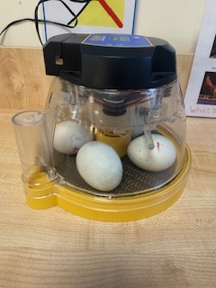
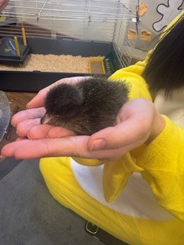
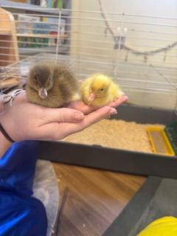
JOB DESCRIPTION
Community Engagement and Nursery Development
Act as a key liaison for Tuesday Tiny Tots sessions, supporting engagement with families and promoting early intervention.
Support nursery marketing and promotional activities, including open events, transition events and community engagement opportunities.
Promote the nursery's ethos, vision and values within the wider community.
Contribute to the ongoing development of inclusive practice across the nursery.
General Responsibilities
Foster a warm, welcoming and inclusive environment where all children feel valued and supported.
Maintain positive relationships with children, families, colleagues and external professionals.
Follow all nursery policies and procedures.
Contribute to the learning environment to meet children’s needs.
Undertake any other duties commensurate with the grade and responsibility of the post.
The duties and responsibilities listed above describe the post as it is at present. The post holder is expected to accept any reasonable alterations that may from time to time be necessary.
‘Home from Home’

Slide 13
PERSON SPECIFICATION
Qualifications | Essential/Desirable | Application/ Interview / Task
Minimum Level 2 qualification/GCSE in Maths and English | E | Application
Relevant qualifications (e.g. NVQ Level 3 in Early Years/HLTA Status/Teaching degree) | E
DSL Level 2 Training or willing to undertake | D
Experience & Knowledge | Essential/Desirable | Application/ Interview / Task
Experience of working with children in a preschool/nursery/school setting | E | Application Interview Task
Training or expertise in a relevant curriculum or other learning area (e.g. Early Years Foundation Stage Framework) | E
Working with pupils with a range of special educational needs | D
Understanding of relevant codes of practice/ and legislation | E
Understanding of child development and learning | E
Working within a creative curriculum | D
Knowledge of health, safety and hygiene practices and requirements | D
Attends staff training sessions where appropriate | D
‘Home from Home’

Slide 14
PERSON SPECIFICATION
Personal Attributes | Essential/Desirable | Application/ Interview / Task
Know how to use a range of teaching and learning strategies to support children’s progress | E | Application Interview
Plan effective activities for pupils | E
Use therapeutic strategies in line with policy to support behaviour | E
Respond to young children’s needs | E
Understands the importance of the unique child within a holistic approach | E
Work independently and able to work effectively as part of a team | E
Remain calm under pressure and be able to adapt to change quickly | E
Show genuine care and respect for young children and their families and a commitment to working with them | E
Have empathy with those facing barriers to their learning | E
Contribute to a purposeful learning environment | E
Encourage children to interact and learn cooperatively with others | E
Respond to guidance and proactively seek CPD opportunities | E
‘Home from Home’

Slide 15
PERSON SPECIFICATION
Personal Attributes | Essential/Desirable | Application/ Interview / Task
Be a positive role model | E | Application Interview Task
Ability to recognise the importance of confidentiality at all times | E
Use ICT effectively | E
Record basic children’s data | D
Assist with escorting children on educational visits | D
Safeguarding | Essential/Desirable | Application/ Interview / Task
Has up-to-date knowledge of relevant legislation and guidance in relation to working with, and the protection of, children and young people | E | Application Interview
Displays commitment to the protection and safeguarding of children and young people. | E
Possession of a current Basic First Aid or Paediatric First Aid certificate | D
Possession of Level 2 Safeguarding certificate | D
Willingness to undertake training for these qualifications | D
‘Home from Home’

Slide 16
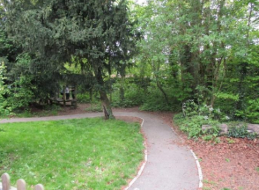
Please contact us with any questions.
Thank you
We look forward to beginning our adventure together with you
‘Home from Home’
15

Slide 17
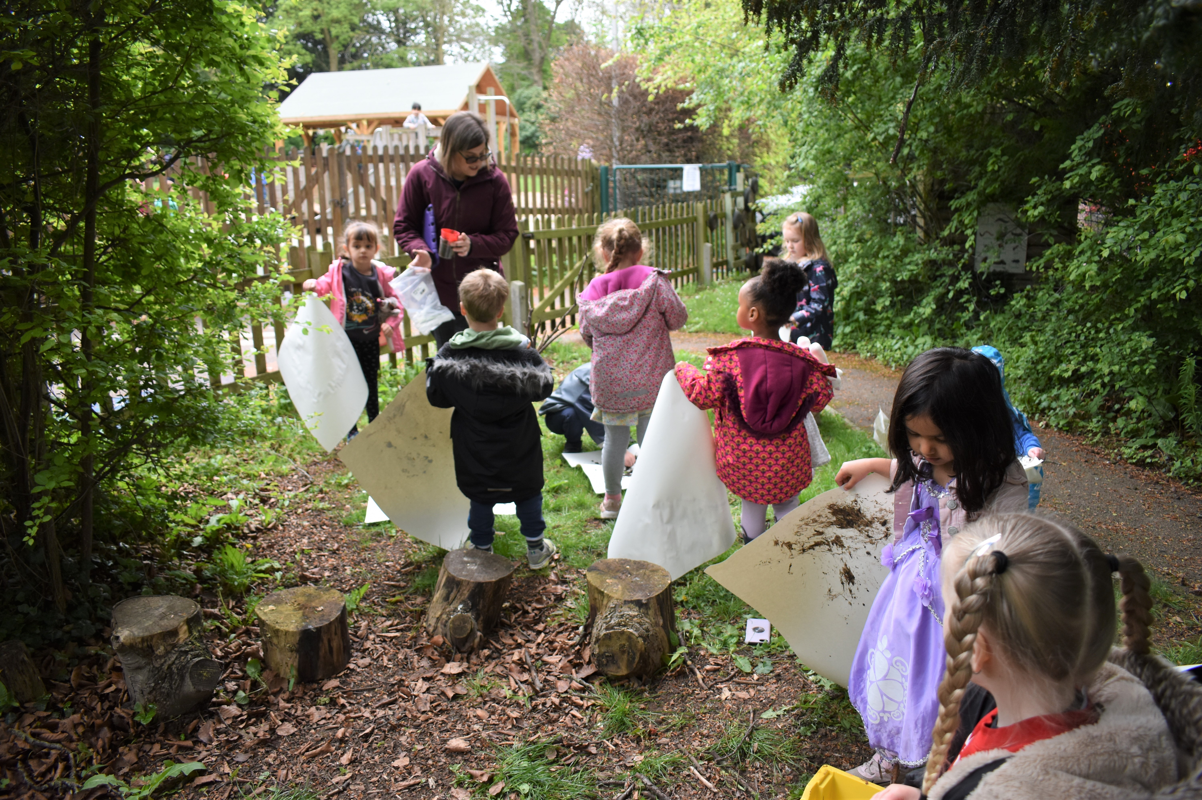
www.westonway.herts.sch.uk
17
‘Home from Home’

