Slide 1
Nascot Wood Junior School
Senior Leader Person Specification
2024

Slide 2
Context
Two-form entry Junior School, 20 miles from the centre of London
Sunday Times top 100 schools list
Top 1% of schools in the country
Most oversubscribed school in Hertfordshire
75% of leavers gain places at schools with entrance exams

Slide 3
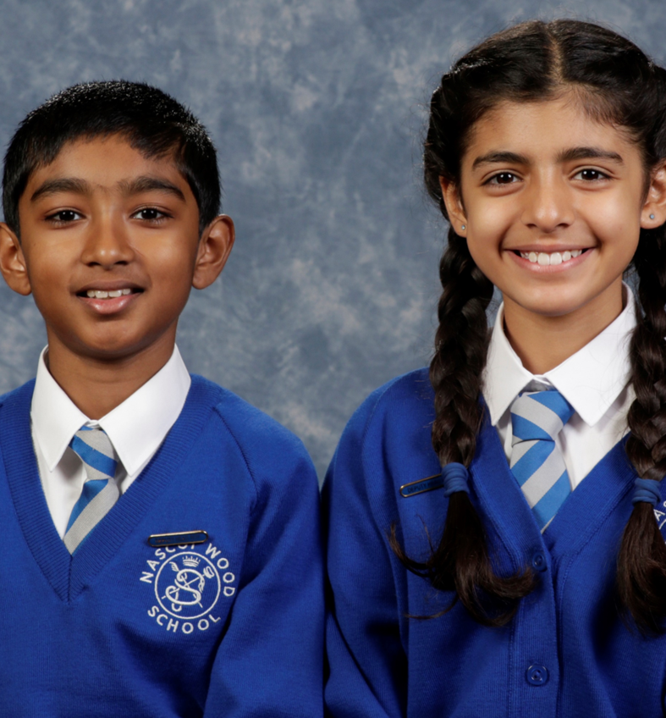
Leadership context
At Nascot Wood Junior School we have a stable, well established, Senior Leadership Team, where the Head and Deputy Headteacher have worked collaboratively for ten years, with a shared approach to leadership. We have developed a soft leadership style, where we have focused on transformational and democratic change. We have achieved this by being creative, collaborative, organic and long-term focused.
In a recent staff survey, 100% of the staff said that they were proud and happy to work for the school.
Following our Ofsted inspection in October 2023, which resulted in a judgement of outstanding in all areas, we are ambitious to develop the school further, by pursuing new ideas and initiatives with the recruitment of a new Senior Leader.
The Senior Leadership Team currently consists of a non-teaching Head and Deputy and a Class Teacher with Senior Leadership responsibility. The new post would focus on the leadership of lower key-stage 2, collaborating with the leader of upper key-stage 2 to ensure cohesion across the school.

Slide 4
We are seeking…
an aspiring leader, to take up the position of Lower Key Stage Two Phase Leader in our school.
The successful candidate will have had some opportunities for leadership within their teaching role.

Slide 5
Person specification
Criteria | Essential | Desirable
Qualifications | Qualified Teacher status | Broader qualifications, for example, NPQs, National SENCo award etc.
Knowledge, understanding and experience | UPS 1 (MPS 5/6 with other relevant experience) Detailed knowledge and experience of the KS2 curriculum Track record of subject leadership experience Good communication skills, both orally and in writing | Teaching experience across both KS1 and KS2 Experience of mentoring a student, ECT or other colleague Experience of leading Mathematics

Slide 6
The successful candidate will be/have:
Resilient
Collaborative
Diplomatic with a commitment to soft leadership
Willing to learn
Organised and proactive – ability to manage own workload
Creative
Reflective
Flexible
Solution-focussed
Growth mindset
Hardworking with a meticulous attention to detail
A kind nature
Investment in the school ethos

Slide 7
Context: Results 2023

Slide 8
Context: Closing the gap

Slide 9
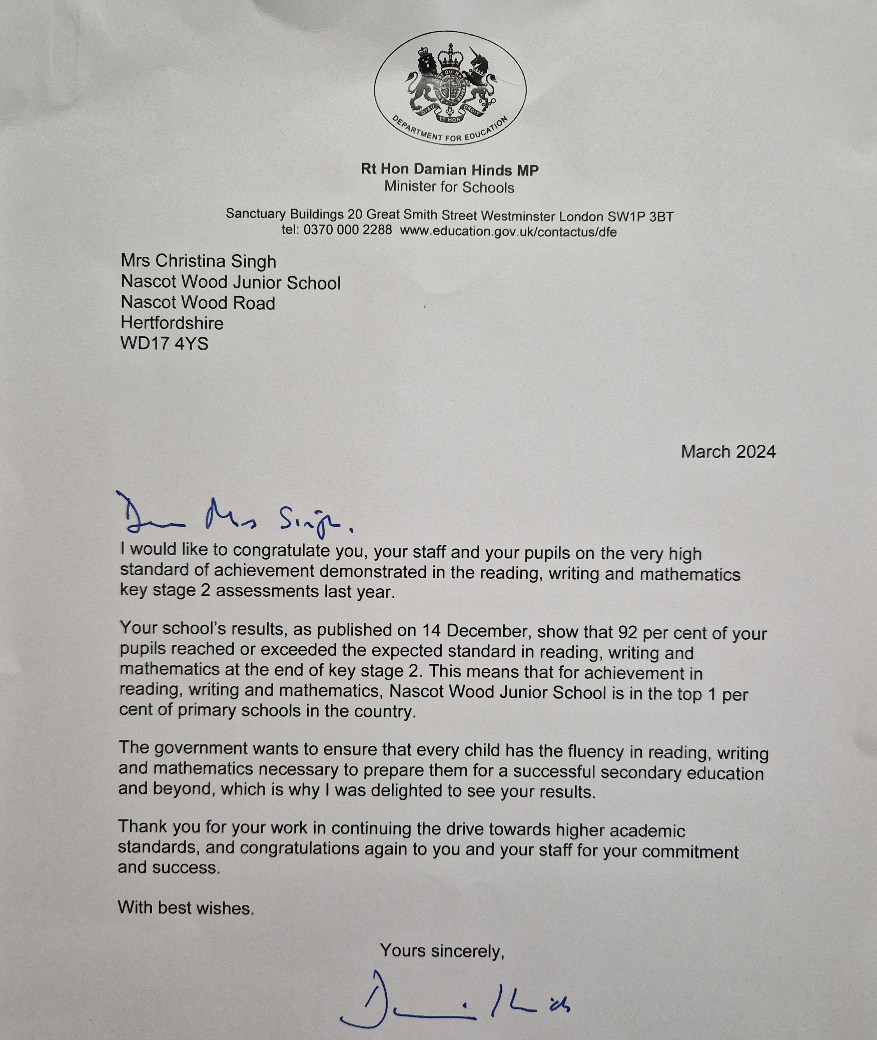
Context

Slide 10
'It's hard to sum up this unique school. I can't wait to start school each day, everything you want to do as a Teacher you have the opportunity to do here; you fall back in love with teaching.' Class Teacher
‘This school adjusts to meet the needs of the child; it doesn’t expect the child to adjust to meet the needs of the school’ Advisory Teacher, Autistic Spectrum Disorder
'Senior leaders have an accurate, thorough and comprehensive view of school effectiveness. Self-evaluation is strong, rightly identifies strengths and leads to identification of areas on which to focus development. The headteacher and senior leadership team have created, and sustain, an enviable culture of excellence (both academic and artistic) and the valuing of lifelong learning and high aspiration. As a result, pupils are exceptionally well prepared for the next step of their education' Hertfordshire Improvement Partner
'My vision for education is that all schools in this country would be like this one' Rt. Hon Nick Gibb, Minister for school standards (2015-2021)

