Slide 1
Governor Candidate Pack
Weston Way Nursery School
‘Home from Home’

Slide 2
‘Home from Home’, where as a family, we play, learn and grow in our journey together, shaping the future.
“
”
Our Vision

Slide 3
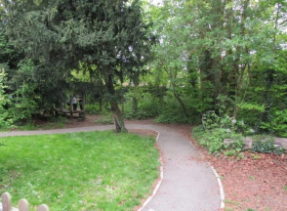
Headteacher’s Welcome
A warm welcome from me and everyone else involved in the life at Weston Way Nursery School.
Our nursery is at the heart of the Baldock community since 1942 and we are in the midst of plans for our 80 year celebration. We have a strong vision rooted in our ‘Home from Home’ feel, whereby we offer quality early years provision for 3-4 year olds from 8.00am-5.00pm Monday to Thursday and 8.00am-4.00pm on a Friday. During this time, the children have the opportunity to play and grow in our extensive grounds surrounded by the most wonderful woodland which enables our families to fulfil our aims: Happiness / Opportunity / Magical Moments / Engagement.
Our inspiring practitioners at Weston Way Nursery School strive to ensure the needs of every child are met through our well thought out curriculum that is unique to us. We value our partnerships which enable us to build relationships as we seek to offer each child the best start in life.
At Weston Way Nursery School, our Governor role is an essential role within our the leadership of the whole nursery which we all hold in high regard. Our new governor will be someone who recognises the importance of the strategic role they have as part of ensuring quality outcomes for our children through the various responsibilities. We work together as a team and there is always someone on hand to help. We have built a culture where no question is a silly question and we seek to find resolve. Each day brings new challenges and we act quickly to meet the nursery’s ever-changing needs.
Our website provides an overview of everything we offer but please visit us to feel our warm and nurturing environment for yourself. We look forward to hearing from you.
Kelly Nichol
Headteacher
‘Home from Home’

Slide 4
Candidates Information
Visits to the school | admin@westonway.herts.sch.uk 01462 892172
School website | www.westonway.herts.sch.uk
School address | Weston Way Nursery School, Weston Way, Baldock, Hertfordshire, SG7 6HD
TeachinHerts | https://www.teachinherts.com/find-a-job/view,chair-of-governors_93113.htm?preview=c791c3e9c6ee3e4e16ba5ac1a99deec1
‘Home from Home’

Slide 5
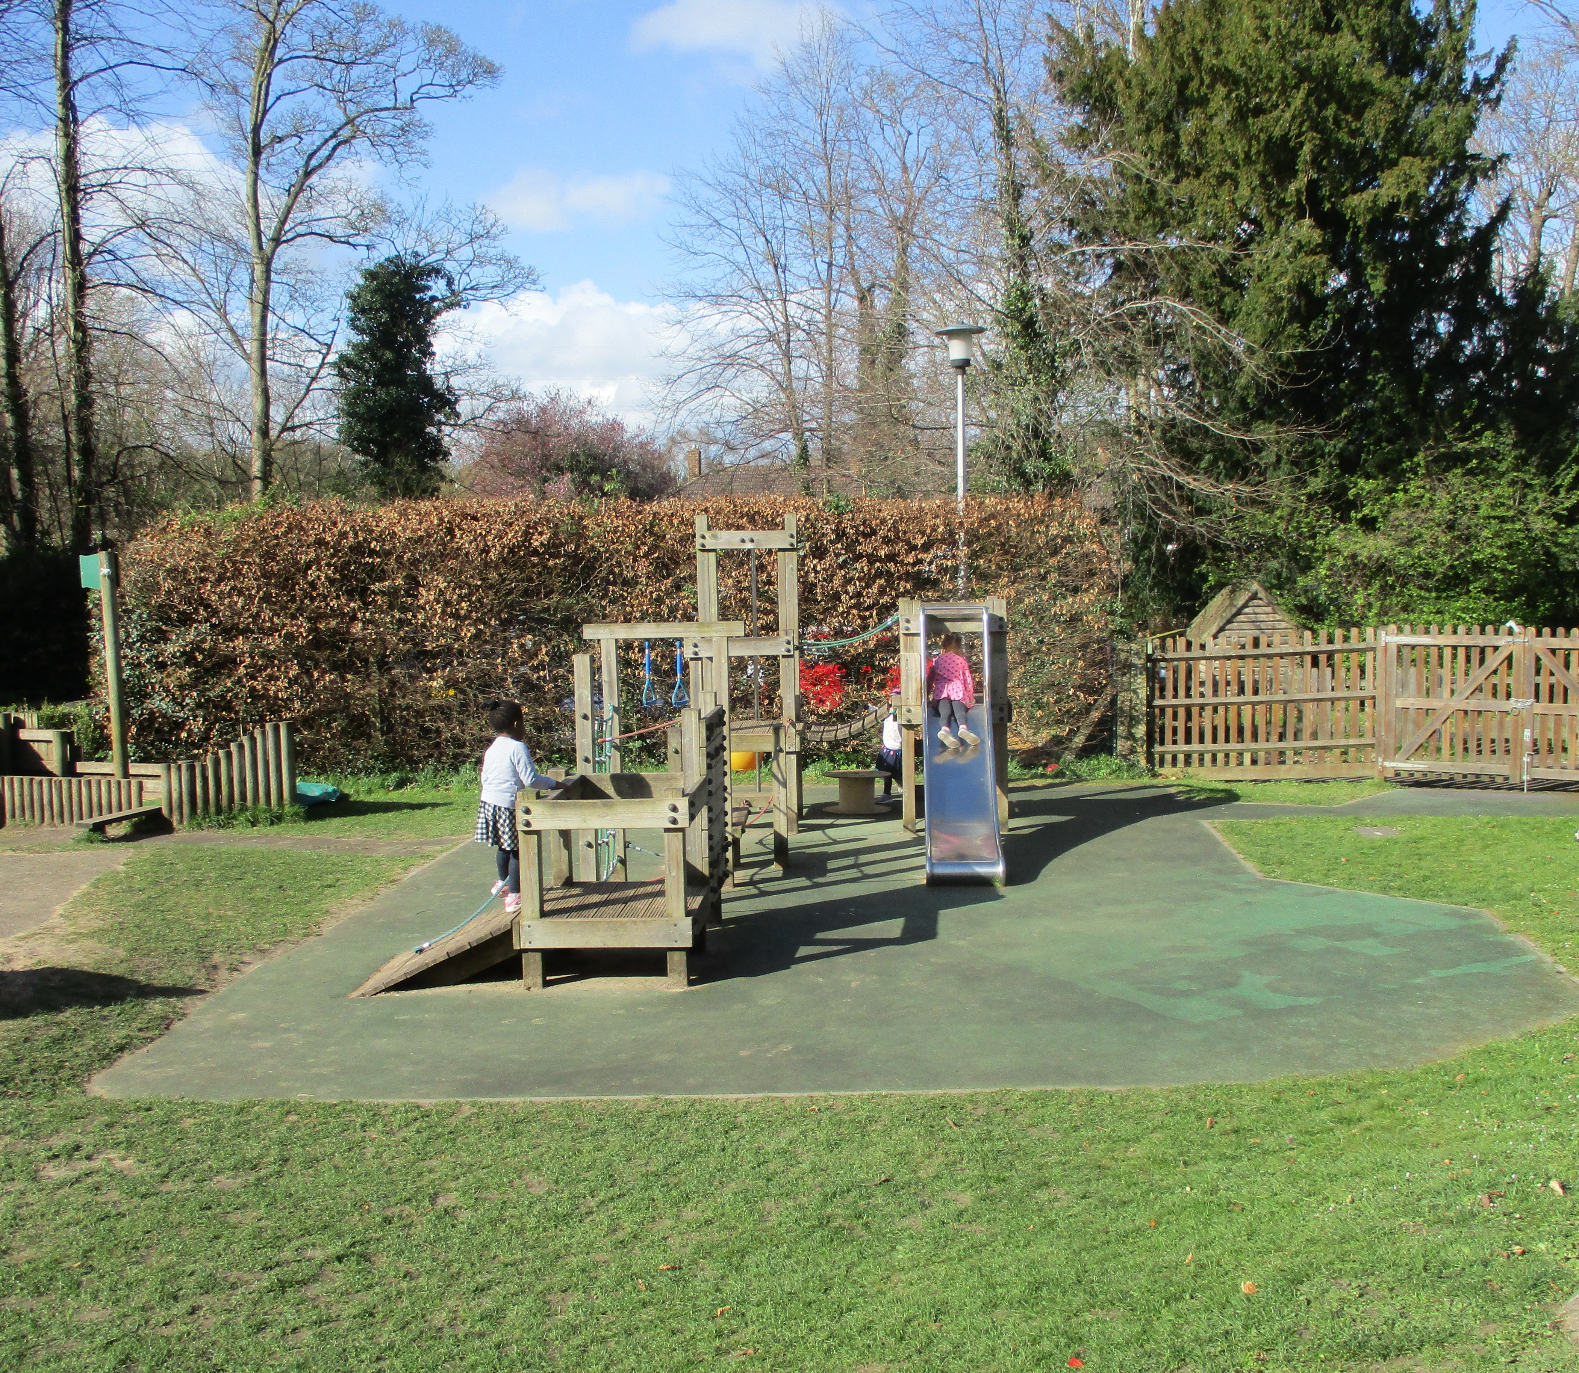
Candidates Information
WWN
Application
Application may be via the Teach in Herts online application form. Alternatively, potential candidates may like to get in touch with the nursery school to learn more about the governor role we have available.
Personal Statement
Your Personal Statement is a very important section of the application process and explains why you would like to be a governor at Weston Way. When writing this, be sure to give evidence of your skills, knowledge and experience. Although there is no set word limit for this, try to keep your statement within a paragraph.
References
Preferred references are from your last two employers, and you should provide their official organisation email address for us to contact. It will be helpful if you can make them aware of your application.
‘Home from Home’

Slide 6
Key Information
Type of school | Community maintained
Ofsted rating | Outstanding
Age range | 3-5 years
Number of children on roll | 79
Number of children on SEND register | 11
Number of children with EAL | 13
Number of children eligible for EYPP | 13
‘Home from Home’

Slide 7
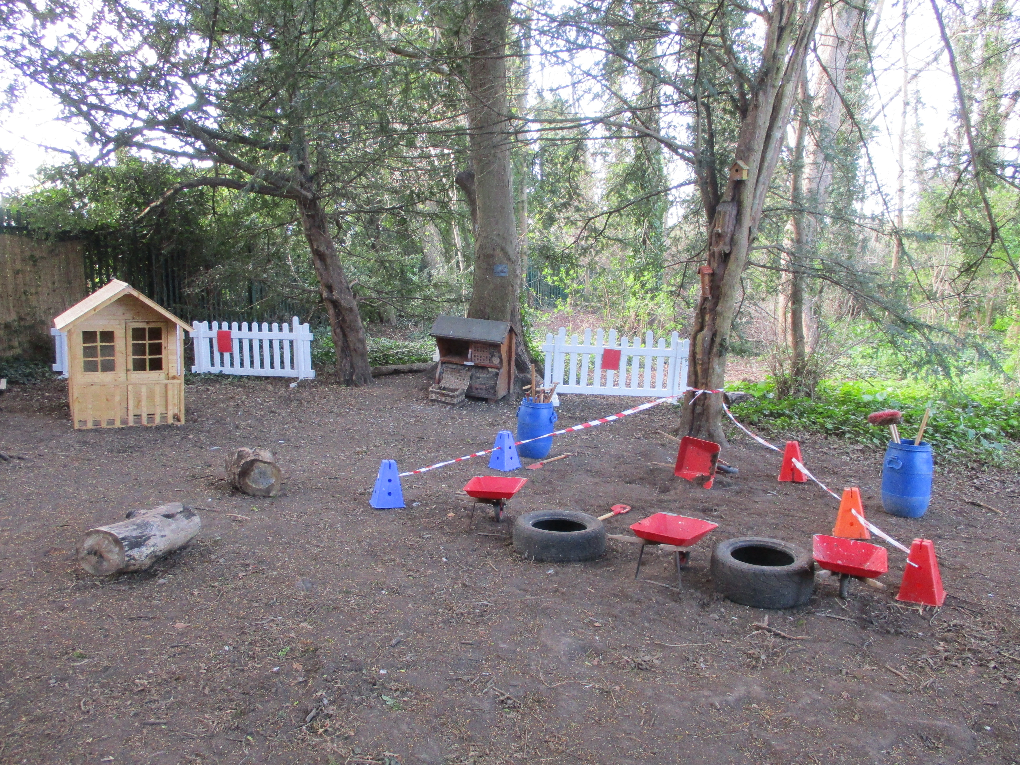
Safeguarding
S
Weston Way Nursery is committed to safeguarding and promoting the welfare of children and expects all staff and visitors to share this commitment. Appointment to this post will be subject to a Disclosure and Barring Service (DBS) enhanced check, as well as other pre-appointment checks outlined in our Safer Recruitment Policy.
‘Home from Home’

Slide 8
Essential functions of the Governing Board
The 3 core functions of the governing board:
Ensuring clarity of vision, ethos and strategic direction
Holding executive leaders to account for the educational performance of the organisation and its pupils, and the effective and efficient performance management of staff
Overseeing financial performance of the organisation and making sure its money is well spent
To find out more about governance click on the DfE link:
https://www.gov.uk/guidance/governance-in-maintained-schools

Slide 9
Thank you
We look forward to beginning our adventure together with you
‘Home from Home’

