Slide 1

Title Page
Staff Handbook
2024-2025
School Website
https://pixmore.herts.sch.uk/

Slide 2


Instructions
This document outlines the basic key information members of staff need to know for the academic year 2024-2025.
This is an interactive document. Click on underlined blue text hyperlinks to take you to the relevant page, document or website being referenced.
References to key policies which must be read along side this handbook are written in red for ease of identification. Click on the underlined red text to access a hyperlink opening each policy.
Team Pixmore prides itself on being a friendly and welcoming team so if you have any further queries, please speak to your line manager/mentor who will do their best to help.
This button on each page will take you back to the contents list.
CONTENTS

Slide 3
Contents
Administration
Absences
Communication
Office procedures
Record keeping
Equipment
School Day
Timings
Before school
Registration
Assemblies
Clubs
Playtimes
Playground duty
Playtime rules
Adventure/Gym equipment and tyres
Wet playtime
Keeping children in
Lunchtime duty
Safeguarding
Policies and CPOMS
Health and Safety
First Aid and medical needs
Fire drills
General information
Team Pixmore
Overview
Leadership and year group teams
Administrative and midday supervisory teams
Safeguarding and premises teams
Governing body team
Staff conduct
The Nolan Principles
Ready, respectful, safe
Teaching standards
SEN
Inclusion
Curriculum
Curriculum planning
Curriculum responsibilities
Rosenshine’s Principles
Classroom organisation
Displays
Home learning
Home learning continued
Promoting the curriculum and learning
British Values- Pupil Roles
Behaviour for Learning
The Pixmore Way
Rewards
Sanctions
Pixmore Learning Power (PLP)
Zones of Regulation

Slide 4

Safeguarding
https://pixmorejun.cpoms.net/
All staff must have the relevant DBS disclosure before they are able to work with children.
All staff must undertake essential induction training before starting to work with children. This includes:
  Reading this staff handbook
  Reading the Child Protection Policy
  Reading Keeping Children Safe in Education Document (KCSIE)
  Reading the Online Safety Policy
  Reading the Data Protection Policy
  Having an induction meeting to discuss queries and plan further support and training required.
All members of staff have a duty of care to immediately report any wellbeing and safeguarding concerns, no matter how small, to the Designated Senior Person (DSP) Mrs Sue Willans, or a Deputy DSP (Sarah Inman or Charlotte Pocock).
Every member of staff will be issued with a CPOMs account. All concerns must be logged on CPOMs within 24 hours.
Every member of staff will be required to undertake annual Safeguarding training (which includes Prevent and online safety elements).
CONTENTS

Slide 5

First Aid & Medical Needs
All staff need to read the Medical Needs Policy
All staff must have a basic emergency first aid for schools certificate. School will provide training for this. Any staff who miss the training will need to book an alternative date.
In addition, there are fully qualified first aiders at work in the school (Aimee Budd and Dan King have had the Pediatric First Aid training.)
Epi-pen training is held yearly and Pixmore is a NUT FREE SCHOOL.
Staff should be aware of children in their class who suffer from medical conditions including asthma and should check this information at the beginning of the year. This information can be found on Arbor, and in the Medical Needs register in each class Red Inclusion Folder Any queries should be addressed to Noreen Flanagan (First Aid and Health and Safety)
The SENCO will alert staff to children who have a ‘care plan’ or Education and Health care Plan that impacts on their ability to cope and function in a classroom setting.
Medicine can be administered by staff if has been entered in the medicine log and signed by the parent and the supervising member of staff. The medicine log is kept in the school office.
Please check the staffroom noticeboard for information on life threatening illnesses affecting some children that all staff should be aware of.
Dan King is the member of staff who has overall responsibility for first aid supplies and if there are concerns over ill children.
Accidents requiring first aid must be recorded in the first aid book for the relevant year group.
If a child has a head injury, parents must be informed via a head letter and phone call home.
CONTENTS

Slide 6

Fire Drills
The fire bell can be identified by its loud and continuous ringing.
On hearing the bell, all staff should follow the agreed procedure outlined in the room or area they are in at the time.
The children should be lead out onto the top playground by their teacher to line up silently in front of the numbered circles. (Year 3→1+2, Year4→ 3+4, Year 5→ 5+6, Year 6→7+8) where registers will be given out and a head count taken.
Children must line up SILENTLY in register order and it is important to ensure that the children are aware of this order by practicing lining up in register order regularly in class.
LSAs and BSAs should ensure all pupils have left the classrooms/ toilet area and close the door behind them as they leave.
Nothing should be taken outside by staff or pupils except for the office staff who will bring out the paper registers and the school inhaler and epipen.
Teachers indicate they have completed roll call for the pupils and staff in their class by standing at the front of their class line holding the register high in the air.
Fire practice drills will be held half termly and at different times of the day across the year to allow all children and staff to be aware of procedures.
CONTENTS

Slide 7

Health and Safety
Staff need to be aware of the Health and Safety Policy and should read this as part of their induction.
If staff have a concern in the area of Health & Safety, they should discuss it with Mrs Flanagan who represents staff on the Resources Committee and also speak to the Caretaker, George Anderson.
The Headteacher is also available if staff feel the concern warrants further investigation.
A maintenance book is located in the caretaker’s office-Caretaker’s Log book
Please note if any repairs are required, please date and sign them- and leave the book out for the attention of the caretaker.
Please read all relevant risk assessments and work with your year group partner to complete risk assessments for trips and walks in the local area.
Permission is needed and entered into the Asbestos log book if the fabric of the building is to be damaged in any way by repairs, displays and maintenance.
All accidents on the premises involving pupils or staff must to be logged. Please see Mrs Flanagan for accident forms.
CONTENTS

Slide 8
Team Pixmore Overview
Safeguarding Team
Governing Body Team
Headteacher
Leadership Team
Administrative Team
Midday Supervisory Team
Premises Team
Together we promote being:
Ready
Respectful
Safe
Teaching Teams
Learning Support Team
Behaviour Support Team
CONTENTS

Slide 9
Year Group Teams
Leadership Team
Headteacher -Mrs Sarah Inman
Assistant Headteacher (SENCO)-Mrs Sue Willans | Assistant Headteacher (LKS2 Lead)-Miss Charlotte Pocock
Senior Leader Teacher (UKS2 Lead)- Mrs Karen Bowden
 | Class Teachers | Learning Support Assistants (LSAs) | Behaviour Support Team (Key Workers) | PPA (&ECT) Cover
Year 3 | Mr Dwayne Merrick Miss Tia Tungamirai | Mrs Tina Court (HLTA) Mrs Kimberly Baker | Mr Daniel King | Mr Adam Willard (PE) Mrs Sarah Thomas (Art)
Year 4 | Miss Charlotte Pocock Mrs Elaine Herron Miss Victoria Fortune | Mrs Maria Glazhofer Mrs Jane Gibson | Miss Aimee Budd | Mr Adam Willard (PE) Mrs Sarah Thomas (Art)
Year 5 | Miss Emily Piper Ms Jessica Stephens | Miss Stephanie Lawless Mr Dave Wright Mrs Noreen Flannagan Mrs Guncha Elsawahli | Mrs Nicola Bendon | Mr Adam Willard (PE) Mrs Sarah Thomas (Art)
Year 6 | Mrs Karen Bowden Miss Katie Graby | Miss Holly Edwards Mrs Amie Stone (HLTA) | Miss Kim Dougherty | Mr Adam Willard (PE) Mrs Sarah Inman (Art)
CONTENTS

Slide 10
Administrative Team
Office Manager | Mrs Sharon Jarvis
Office Administrator | Mrs Dawn Jones
Librarian | Mrs Noreen Flanagan
Website Manager | Mrs Sarah Inman/Miss Charlotte Pocock
Social Media Manager | Miss Charlotte Pocock
Midday Supervisory Team
Senior Midday Supervisor | Mrs Dawn Jones
Midday Supervisors | Miss. Carol Smith Mr. George Anderson Mrs. Tracey Burby Mrs Amie Stone Miss Holly Edwards Ms Stephanie Lawless Mr Dave Wright Mrs Kimberley Baker Mrs Guncha Elsawahli
CONTENTS

Slide 11
Safeguarding Teams
*Please note every member of staff is responsible for the wellbeing and safeguarding of pupils. The following are the key members of staff to approach for support. All member of staff will receive annual safeguarding training and must read and sign the Child Protection Policy
.
Designated Safeguarding Lead (DSL) | Mrs Sue Willans
Deputy DSLs | Mrs Sarah Inman Miss Charlotte Pocock
Prevent Lead | Mrs Sarah Inman
SEND/Medical/CLA/Post LAC Lead | Mrs Sue Willans
Behaviour Support Assistant/Family Support Worker | Mrs Nicola Bendon/Mr Daniel King
Behavior Support Assistants (Key Workers) | Mr Dan King Ms Kim Dougherty Mrs Nicola Bendon Miss Aimee Budd
Premises Team
Heath and Safety Lead | Mrs Noreen Flanagan
Caretaker | Mr George Anderson
Cleaners | Cleaning Assurance Company
CONTENTS

Slide 12
Governing Body Team
https://pixmore.herts.sch.uk/governors/
Chair of Governors (Co-opted Governor) | Caroline Nicholson | PSHCE, Curriculum, Literacy, SEND & Inclusion, Standards and Outcomes Committee, Exclusion Panel, Complaints Panel
Vice Chair of Governors (Local Authority Governor) | Kath West | Safeguarding & CLA, Complaints Panel, Standards and Outcomes Committee
Chair (RC) Co-opted Governor | Ian Hamilton | Budget & Finance, Exclusion Panel, Complaints Panel, IT and Science
Vice Chair (RC) Co-opted Governor |  | Exclusion Panel, Complaints Panel
Chair (SAC) Co-opted Governor | Catherine Dock | Maths, Pupil data & outcomes, Exclusion Panel, Complaints Panel
Vice Chair (SAC) Co-opted Governor | Sarah Rooney | Premises, Health & Safety, Sports Premium, Resources Committee
Co-opted Governor | Katharine Outhwaite
Parent Governor | Katie Holt | Arts, Pupil Premium, Standards and Outcomes Committee
Associate Member | Lindsey Robinson
Parent Governor | Jenny Williams
Associate Member | Susan Cowling
CONTENTS

Slide 13
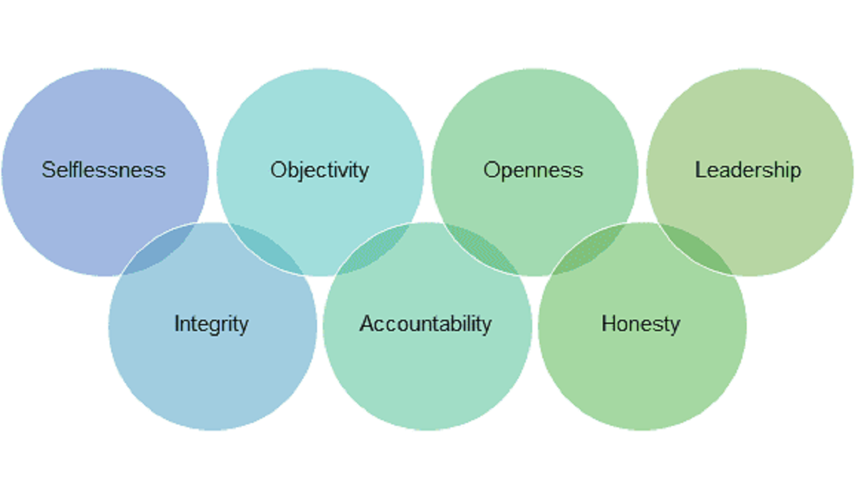
The Nolan Principles
Lord Nolan's Seven Principles of Public Life apply to anyone who holds a public office, including those in the education sector. Find out what the seven principles (following the acronym OOH LISA) are here:
GOVERNMENT GUIDANCE ON THE NOLAN PRINCIPLES
HOW TO REMEMBER THE NOLAN PRINCIPLES VIDEO
Please be aware that as HCC staff you may be party to confidential information about a child/family/incident and that information should respectfully be contained amongst the relevant staff. Failure to do so which may aggravate or exacerbate the issue is a discipline matter.
CONTENTS

Slide 14

Ready, respectful, safe
Staff are expected to promote and model the school values of being ready, respectful and safe. This includes:
  Following all school policies.
  Wearing your identity badge at all times.
  Wearing smart casual clothes for your professional role (no jeans, no G strings showing or T-shirts with slogans , low tops or short dresses and cleavage showing!) If there is a ‘Dress Down Day’/INSET/school trip, jeans are permitted.
  Being punctual
  Being on the Pixmore Team bus!
It is the responsibility of all employees to read and sign the following policy documents referring to Pixmore’s expectation of code of conduct:
  Staff Code of Conduct
  Whistle Blowing Policy
CONTENTS

Slide 15

Teaching Standards
As well as adhering to Pixmore’s policies, staff will also be expected to follow the relevant teaching standards.
  Headteacher standards
  Teaching standards
  Early Carers Teaching Standards
  Learning Support Assistant Standards
CONTENTS

Slide 16

Absences
If you are too unwell to come to work, it is a requirement you contact your line manager or other nominated appropriate person as well as the school office to report your absence. You should aim to do this as early as possible and before your normal start time. (Ideally by 6.45am for teaching staff and by 7am for support staff)
Key Contacts→ Sarah Inman: 07990974381, Sue Willans: 07931 809728, School office: 01462 620555.
For each subsequent day of absence after the first day, you should contact your line manager as early as possible and before your normal start time.
Self-certification forms must be completed for illness absences over 2 days. A doctor’s certificate is required for longer absences of 7 days or more.
The office administration logs all absences. Frequent absences will be referred to the HR/OH team if informal school action does not show an improvement in absence.
Please read the Staff Health, Absence and Attendance Policy for further information.
CONTENTS

Slide 17


Communication
There are two whiteboards in the staffroom for whole school communication: one gives daily information; the other for the week ahead. Both boards should be checked first thing each morning by every member of staff.
There is one staff meeting for teaching staff per week: 3.30-5pm on Tuesdays for CPD including diary dates. (Teaching students on placements are encouraged to attend these meetings)
LSAs and MSAs will have a meeting twice termly with the SENCO.
BSAs meet once a month after school for a team meeting.
Work experience staff, volunteers and support staff may be required to attend whole staff training sessions on INSET days or as twilight sessions. Staff will be informed of these training dates ahead of time. Some training will be compulsory.
Minutes are kept for each meeting and emailed out. Staff unable to attend a meeting are expected to read the minutes.
Every member of staff has a school email, which they are expected to check daily.
Every member of the BST, SLT and each year group has a walkie talkie for communicating in emergencies
Please read and sign the ICT Acceptable Use Agreement in relation to using technology for communication.
NO MOBILE PHONES OUT IN CLASSROOMS (adults and pupils).
Children’s mobile phones must be collected in each morning by the class teacher and locked away in the year group cupboards, they should not be in lockers, bags or in drawers.
CONTENTS

Slide 18
Office Procedures
Staff post and messages (including pay slips) will be delivered to individuals pigeon-holes in the staff room. Please check and empty your pigeon-hole regularly.
Should you wish to have a school dinner, these can be order through the parent pay system. Please ask the office manager to set you up with an account.
There is a telephone in the staff room for use when phoning parents/carers. Emergency contacts are accessible in the purple folders in the cupboard above the telephone.
Any purchases made on behalf of the school must be agreed by the Headteacher in advance. This also applies to orders placed by telephone. For Petty cash purchases, staff should submit a receipt or invoice showing the items purchased in detail and a company VAT number, to the office manager who will be responsible for any reimbursement required.
Staff should take responsibility for informing children if they know that the club they are running will be cancelled the following week. Parents should be given a week’s notice for foreseen circumstances. The Office will phone parents if the staff member is absent on the day of the club.
Messages from the office to children about changes to home time arrangements are recorded in green books which are delivered at the end of each day. It is the responsibility of the class teachers to ensure these messages are given.
Please be aware that Office staff are always busy! If you would like the Office to undertake administrative tasks for you, then please give them plenty of notice. It would be helpful to avoid the office at the start (until 10.30am) and end of the day.
CONTENTS

Slide 19

Record Keeping
Arbor
Arbor is used by teachers to record and access pupil
information including emergency contact details,
medical information, SEN/PPG status, attendance and assessment data.
Summative assessment data for each subject is recorded on Arbor termly.
It is the responsibility of each class teacher to keep their own formative assessment records for use in adapting planning and making teacher assessed judgements.
Printed copies of emergency contacts and class lists are available in the purple folders stored in the cupboard above the phone in the staff room.
Individual pupil files
There is a big box for each class kept in the year group cupboards containing individual pupil files (green folders). These are used for keeping paper records of:
KS1 SATS info
Admission form
Home/School agreement
Annual reports
Significant letters
Medical info
Inclusion Folder
Each class has a red lever arch inclusion folder for filing class information sheets, class provision maps and SEN reports for individual children e.g. EHCP plans. These folders are passed up as children move through the school.
CPOMS
All safeguarding concerns are recorded on CPOMS. Each staff member is provided with their own log in.
First Aid
Records of accidents and first aid administered must be recorded in the relevant first aid book for the year group.
CONTENTS

Slide 20
Equipment
Each year group will have access to general everyday equipment e.g. dictionaries, thesaurus, timestable grids, place value counters, scrap paper. In addition:
Spare general equipment e.g. paper, pens, pencil is kept in the stock cupboard of the dinning room
Display resources are kept in the stock cupboard in the craft room
Shared maths resources are kept in the maths cupboard next to the cooking area
Art/Design resources are kept in the art room
Specialist Science equipment is kept in 2 science cupboards in the dining room
Year 3/4 have access to a class set of Chromebooks (10 kept in Year 3 and 20 in Year 4)
Year 5/6 have access to a class set of Chromebook (32 kept in Year 6)
A set of 20 spare Chromebooks is kept in the Quad for use by individual children/to be loaned for pupils learning at home
A school set of 20 iPads is kept in the dining room
Other computing resources are kept in the server cupboard in the lab
Reading scheme books are kept in the school library area
Non-fiction books are available in the school library
It is important that all equipment is used respectfully.
Staff are expected to:
Only take what you need and return equipment as soon as you have finished using it so that it is available for other people to use and the school is kept tidy and organised.
Always lock computing equipment away immediately after use.
Ensure electrical equipment in charged in time for their lesson.
Report any damaged equipment immediately to the relevant subject lead.
Inform the school office if you have used the last of a supply.
Get permission from the headteacher before ordering any additional equipment. Once approved provide office staff with a list of the resources required well in advance of them being needed so that they can be ordered.
.
CONTENTS

Slide 21

Timings
Teaching staff must be available in their classrooms from 8.30am each morning and should arrive at school by 8.20am at the latest. Doors are opened at 8.30am and pupils should come straight into class.
Learning support assistants should be in their area by 9.00am to see the children into their areas (unless otherwise stated in their contracted hours)
The gates are closed at 8.45am. At this time, all external doors should be closed and late arrivers must enter and sign in via the office.
At the end of the day, teaching staff should take it in turns to be outside their area for parental/carer contact. A member of the SLT will be outside near the playground gate at the end of the day.
For health and safety (fire risks) reasons, all staff should sign in at the office on arrival and sign out if they leave the premises during the school day (signing in again when they return). Please close the vehicle gates when you are entering and exiting the premises to ensure children’s safety.
8.30-8.40am | Doors open- Children filter in and complete early morning work
8.40-8.50am | Registration (doors close at 8.45am)
8.50am-9.30am | Lesson 1
9.30-10.30am | Lesson 2
10.30-10.45am | Break
10.45-11.45am | Lesson 3
11.45-12.15am | Lesson 4/Assembly*
12.15-1.15pm | Lunch
1.15-2.15pm | Registration + Lesson 5
2.15-3.15pm | Lesson 6 + Preparing for home time
*Monday-Head’s Assembly
Tuesday- SLT Assembly
Friday- Celebrations Assembly
CONTENTS

Slide 22

Before School
The school gates are open from 8.00am for pupils arriving for morning club.
Children not attending morning club are not expected on school site before 8.30am
Year 3+4 enter through the pedestrian gate by the playground. Year 5+6 enter through the pedestrian gate by the nursing home.
Doors open at 8.30am. Pupils should come straight into school when they arrive to complete early morning work and get ready for the day.
A member of SLT or BST will stand by each pedestrian gate to welcome pupils and parents to school.
In bad weather, Year 5+ 6 may have to enter through the hall as the Year 6 playground is prone to flash flooding!
CONTENTS

Slide 23
Registration
https://login.arbor.sc/
Attendance registers are completed by 8.40am and at 1.15pm.
Registration is completed online using Arbor. Each member of staff must use their personal log in to complete registers. If for any reason Arbor is inaccessible, a paper register (available from the school office) must be completed.
Supply teachers must complete a paper register (available from the school office).
AM attendance- / PM attendance- \ absence- O
Pupils who arrive after the register has been completed, must go to the school office to be registered/signed in.
Lunch choices are selected by parents at home. Sometimes parents forget to do this so it is worth double checking each morning with the children that they have a packed lunch or their parents have selected a lunch choice. Please inform the school office immediately of any child who does not have a lunch.
CONTENTS

Slide 24

Assemblies
All children are to attend assemblies. If there is a reason for a child not to attend, the Headteacher must be consulted. Where the assembly is of a religious nature, parents may request that their child be excused. In these instances, the matter must be discussed with the Headteacher and the child should be given work to complete in the dining area during the assembly.
Assembly schedule : -
  Monday 11.45–12.15: Whole school values assembly (Headteacher/Assistant Headteacher) (Year 3+4 team meetings if required)
  Tuesday 11.45–12.15: Whole school world/school events assembly (Lead Teachers)
  Thursday 9.00-9.30: Assembly only when there is a year group parent assembly
  Friday 11.45pm –12.15: Whole School Celebration Assembly (Headteacher / Assistant Headteacher) (Year 5+6 team meetings if required)
Children are expected to enter and leave the hall in silence sometimes listening to the music of the week.
Staff are expected to help supervise during assembly and model the expected behaviour i.e. not chatting or bringing work into assembly!
A timetable outlining the weekly themes/thought of the week will be circulated at the beginning of each term.
Each year group will lead an assembly once a term to celebrate their learning. This is performed to the school from 9-9.30am and then to parents from 9.30-10am.
CONTENTS

Slide 25
Clubs
Pixmore offer a range of clubs both before school, at lunchtime and after school.
Some clubs are run by school staff and some are run by external providers. All Teachers including SLT are expected to run a club (lunch time or after school) for at least one term during the school year.
A clubs letter is sent out to parents at the beginning of each term for pupils to sign up to clubs.
If a pupil signs up for a club they are expected to attend each week unless absent from school.
Any member of staff wishing to run a club must get the permission of the headteacher and then organise the details ready to go in the clubs letter at the beginning of the next term.
A list of pupils attending each club is available from the school office. A register should be taken at the beginning of each club.
CONTENTS

Slide 26

Playground Duty
Teachers and LSAs will undertake playground duty once a week. BSAs will have multiple duties a week to ensure there is always at least one BSA on duty. Work experience personnel will be required to go outside at break times and/or lunchtimes.
Playground duty entails supervising the children at morning break between 10.30-10.45am. Please check on the staff room notice board for the timetable. During your duty please ensure:
You are out on the playground promptly at 10.30am.
All areas are monitored so that all children are adequately supervised. In particular, one member of staff needs to be near the adventure playground equipment (outdoor gym, tyres and trim trail) and one monitoring the Y6 playground.
Two minutes before the end of playtime, send a child to the staffroom and Brunch Club to say the bell has been rung. This will enable all staff to be back in classes to guide children in at 10.45am.
At 10.45am promptly ring the bell once for pupils to stop and stand still then a second time for children to put equipment away and walk to line up in class lines. (Year 3 at the top of the Y3 steps, Year 4 at the top of the Y4 steps, Year 5 at the top of the Y5 steps and Year 6 on the Y6 playground)
Class teachers should come out at 10.45am to lead children into class.
LSAs should be deployed to supervise the children through the cloakroom. (Strategies should be developed within each class to ensure that the children store their clothes and shoes tidily and move through the cloakroom quickly and safely.)
CONTENTS

Slide 27

Playtime rules
Each year group has their own colour coded equipment- it is the year group’s monitors responsibility to check equipment and tell Mr Willard if there is a problem with it.
Children should not take equipment from the PE store for playtimes.
Children are not to bring in their own toys from home. (‘Focus aid’ toys given by the SENCo should not be taken out to play.)
Sponge balls only to be used on playground (2 per class available)
Children also have access to a basketball.
Children can play football once a week following rota (Monday-Y3, Tuesday-Y4, Wednesday-Y5, Thursday-Y6)
At lunchtimes ONLY, the children are allowed into the top woodland area once they have eaten their lunch. At least one adult should supervise this area and do a safety sweep before allowing the children inside.
The covered area outside each year group door is the ‘quiet area’ and is for walking, quiet games and lego only. There must be no running in this area due to the paving slabs /blocks which are a trip hazard.
From September, the children must be wearing wellies and coats to use the field and woodland. Children can go in any areas.
Children are expected to follow the Pixmore Way. This includes no play-fighting or gymnastics whatsoever.
Consequences for poor playground behaviour should be given in line with the Pixmore Way. Ideally restorative justice should be carried out during break/lunchtime and not in lesson time.
CONTENTS

Slide 28
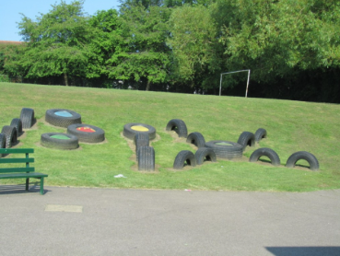
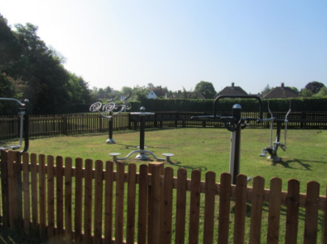
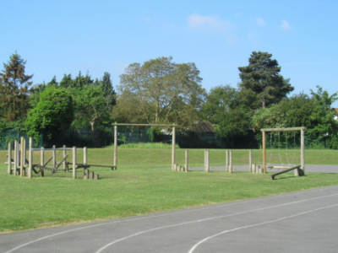
Adventure/Gym Equipment and Tyres
To ensure the safety of the children, all staff should have read the playground/play equipment risk assessment.
The following playground rules should be followed:
Children should wear appropriate footwear i.e. wellies to go on the field, flat soles and should have a coat in school
Children must not push, or put themselves or others in danger
Children who behave inappropriately will not be allowed to use the equipment for the rest of the session
Children should not go on to the equipment until the supervising adult has given them permission
One member of the duty team needs to supervise the children on the equipment at all times
The equipment should not be used if the ground is wet or slippery – staff on duty to make this decision.
The equipment is only for use at break and lunchtimes
The Caretaker will carry out a safety check before school everyday including the woodland
CONTENTS

Slide 29

Wet playtime (extreme wet/cold)
It is the responsibility of the duty team to decide, and inform the rest of the school, if it is extremely wet or cold and poses a Health & Safety risk
In the event of wet play there must be at least one TA in each year area to supervise the children.
The duty teachers will check the whole school.
The behaviour support team will provide additional support during these times.
Work Experience personnel remain with the year group they are working with that day.
Quiet wet play activities (colouring, card games etc) should be available in the area.
At the end of play time children should tidy away and be reading or undertaking a silent activity by 10.45am so that lessons can start promptly.
CONTENTS

Slide 30
Keeping children in at playtime
Brunch club is available daily in the Quad at lunchtimes. Pupils can only attend Brunch club if agreed by their class teacher. (Maximum of 2 children per class at any one time) and must wear a Brunch Club sticker.
If children are in the classroom, they remain the responsibility of the class teacher who should supervise the children at all times.
Children staying in to do general jobs (e.g house captains counting house tokens) should be done in a generally supervised area such as the library/dining room. Children trusted to complete a general job should be indicated by the wearing of a ‘S.P.O.T.’ badge/sticker (special permission of teacher).
Any child who is kept in as a result of their behaviour needs to be outside the Headteacher’s office with work, or will need to be supervised in the classroom by their class teacher or behaviour support worker.
CONTENTS

Slide 31

Lunchtime duty
Staff not doing lunch duty but wishing to leaving site at lunchtime must sign out and back in again when they return.
MSAs on lunch duty will be stationed either in the dining room helping with lunches or outside supervising play. SLT take it in turns to be on first aid duty. MSAs outside should take a small first aid bumbag with them for minor injuries.
It is the responsibility of the senior midday supervisor to organise and deploy staff and to ensure staff know where and what they should be doing each day.
Members of the BST support outside during lunchtime
One member of the BST will run brunch club in the Quad each lunch time. Pupils attending brunch club should each lunch first and then attend brunch club.
Classes are called in for lunch on a rota. Pupils cannot leave the dining room until they have permission from an MSA who has checked the pupil has eaten enough of their lunch.
Pupils must ask permission to come inside to go to the toilet. All pupils use the ‘Year 6’ toilets.
LSAs who are also MSAs should take their lunch break during assembly (on assembly days) and at an agreed convenient time (either straight before or straight after the lunch hour) on non assembly days as directed by their year group timetable.
CONTENTS

Slide 32

Special Educational Needs
Pixmore Junior School is an inclusive school. Staff make reasonable adjustments to ensure that no child is disadvantaged as a result of their special needs or disabilities.
Every class has a Red Inclusion Folder in their year group cupboard to hold details of pupils with additional needs including reports and care plans.
If a member of staff has a concern over a child in relation to barriers to their learning, the SENCO should be made aware and consultation will follow to identify the appropriate course of action to be taken. In consultation with teachers, parents and the child, the SENCo ensures that barriers to learning are minimised and that support is put in place. Reviews take place during October, March and July .
The SENCO attends Pupil progress meetings which are held termly and updates the inclusion register. Teachers are responsible for reviewing and updating class provision maps termly and class overview sheets annually.
Please refer to the Pixmore Special Educational Needs Policy, including the Autism appendix for further details.
CONTENTS

Slide 33
Curriculum
Subject | Average Weekly Time Allocation
English- writing | 4 hours
English- guided reading | 1.5 hours
English- spelling | 1 hour
Maths | 5 hours
Maths- fluency | 1 hours
Computing | 1 hour
Science | 2 hours
Art/DT | 1 hour
RE | 45mins
History/Geography | 1 hour
Learning for Life | 45mins
MFL (French) | 45mins
Music | 45mins
PE | 2 hours
Pixmore prides itself on offering a broad and balanced curriculum with lots of opportunities for developing cultural capital.
It is the responsibility of curriculum lead teachers to monitor, develop and support other teachers to delivery their subject effectively.
It is the responsibility of individual teachers to check planning and ensure lessons will be delivered in a way that is accessible to all pupils in their class.
Year group partners have PPA together weekly so that planning for the following week can be completed as a team.
All planning and resources must be saved on the school server in the relevant year group folder so that it is accessible by all.
Class teachers should have on display in the classroom:
  A weekly timetable
  A visual daily timetable
Teachers should also have a class folder with essential information easily accessible within the classroom in order that continuity in the curriculum can be maintained in the event of supply staff taking the class. This should include:
  Groups (English, maths, guided reading, spelling, monitors )
  Class background sheet
  Year group Provision Map
  Timings for the day
Curriculum Policy
Curriculum Handbook
CONTENTS

Slide 34

Curriculum Responsibilities
Any queries regarding subject planning should be addressed to the relevant curriculum lead.
Assessment Lead | Mrs Sarah Inman
Curriculum Lead | Miss Charlotte Pocock
English- Writing (including spelling) | Miss Charlotte Pocock
English- Phonics | Mrs Beryl Johnson
English- Reading | Mrs Sue Willans/Miss Charlotte Pocock/Mrs Beryl Johnson
Mathematics | Mrs Karen Bowden
Computing | Mrs Nicola Henley & Ms Jessica Stephens
Science | Miss Emily Piper
Art & Design and Design Technology | Mrs Sarah Thomas
Humanities- R.E | Mrs Beryl Johnson and Miss Vicky Fortune
Humanities- History/Geography | Mrs Beryl Johnson and Miss Vicky Fortune
Learning for Life (PSHCE) | Mrs Sarah Inman & Miss Tia Tungamirai
Modern Foreign Language (French) | Mrs Elaine Heron
Music | Mrs Karen Bowden
P.E. | Mr Adam Willard and Miss Katie Graby
CONTENTS

Slide 35
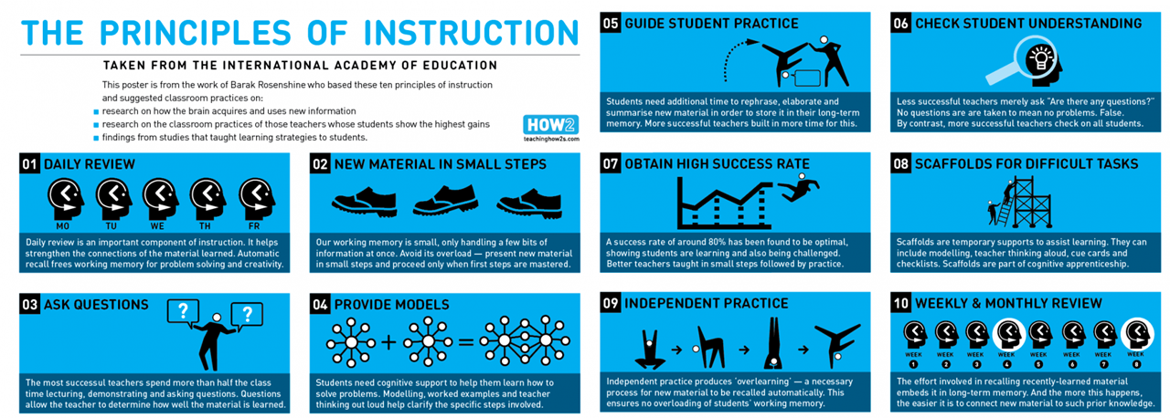
Rosenshine’s Principles
READ THIS ARTICLE BY ROSENSHINE AS AN OVERVIEW OF THE PRINCIPLES
When teachers are planning lessons they should be mindful of Rosenshine’s Principles of Instruction to ensure learning is being structured in a way that is going to support best learning practices.
CONTENTS

Slide 36
Classroom Organisation
To support effective and timely delivery of the curriculum, it is expected that each classroom/year area will meet the following requirements :
Have a well-defined library or book area that is kept tidy and promotes literacy in your year group area
Have well labelled and easily accessible resources so that children can fetch and return them without constant recall to the teacher
Children know where to put finished work for marking and home learning
Monitors are used to enable pupils to take responsibility and help with jobs e.g. handing out books, turning off lights, organising computing equipment
Interesting, visually stimulating displays are used to support and celebrate learning
‘The Pixmore Way’ and behavior ladders are displayed for reference
A ‘time out’ or ‘quiet safe place’ is provided for children
Have an organisational plan for the end of the day which allows for the classroom and area to be left tidy ready for cleaning (i.e. no items left on tables or the floor)
Staff keep their areas tidy and orderly so that any teacher could walk in and find resources and information.
USE THIS CLASSROOM CHECKLIST TO SEE HOW EFFECTIVE A LEARNING ENVORNOMENT IS
CONTENTS

Slide 37
Displays
Displays at Pixmore should either be working walls to support learning or celebrations of learning.
For all displays:
  Work should be attached using staples or blu-tack but not cellotape or drawing pins.
  Work should not block or dangle in front of any motion sensors
For celebrations of learning please ensure:
  The display is backed in backing paper, has a title, a border and an explanation of the work of display.
  Normally, displayed work will be mounted using coloured paper and a backing that enhances the work.
  Work on display should reflect our inclusive ethos but be the highest quality work in relation to each individual child’s ability
  Work is unmarked
For working wall displays please ensure they:
  reflect the current teaching and learning sequence
  demonstrate the process of learning
  provide a source of information and support for children’s learning –e.g. vocabulary, good examples, small step guides
  are updated regularly
CONTENTS

Slide 38
Home learning
The objectives of home learning are:
to enable pupils to make maximum progress in their academic and social development;
to help pupils develop the skills of an independent learner;
to promote a partnership between home and school in supporting each child’s learning;
to enable all aspects of the curriculum to be covered in sufficient depth;
to provide educational experiences not possible in school;
to consolidate and reinforce learning done in school and to allow children to practice skills taught in lessons;
to help children develop good work habits for the future
LKS2 | UKS2
Daily reading (15 minutes) | Daily reading (20 minutes)
Reading Comprehension (15 minutes) | Reading Comprehension (15 minutes)
Daily spelling practice (5 minutes) | Daily spelling practice (10 minutes)
Daily maths fluency (timestable) practice (5 minutes) | Daily maths fluency (timestable) practice (10 minutes)
Weekly Maths (20 minutes) | Weekly Maths (30 minutes)
Half Termly Topic Grid (6 x 30 minutes) | Half Termly Topic Grid (6 x 30 minutes)
essential
additional
CONTENTS

Slide 39
Home learning continued
Across the school home learning tasks will be issued by Friday at the latest and need to be return the following Wednesday. This provides consistency and continuity across the whole school.
Each pupil is provided with a purple exercise book for completing homework in and a home school diary for recording reading in.
All homework must be saved on the server ready for uploading onto the school website each Thursday (except for the topic grids which are uploaded at the start of each half term)
Each year group will provide a homework club once a week to support children in completion of their homework. Currently, these are held at lunch times (usually mid week) and are run by a member of staff from each year group.
Home School Diaries should be checked daily for parental comments.
There is the expectation that home-school diaries should be signed by a member of staff on a weekly basis and if time appropriate, comments with regard to homework or behaviour should also be noted.
CONTENTS

Slide 40
Promoting the curriculum and learning
To promote the curriculum and learning Pixmore use a range of communication with parents/carers including:
School Prospectus- Updated annually for new prospective parents
School Website – year group web page updated termly/half termly and curriculum pages updated as and when
Year Group Curriculum Map- Uploaded annually to the school website
Curriculum Leaflets- Sent home termly and uploaded to the school website
School Facebook page -Each year group is expected to post at least once a week
Marvellous Me – Used to send digital badges celebrating learning home
Meet the teacher- Parent meeting introducing the year group curriculum (Autumn Term)
Parents evenings – Held twice a year (Autumn and Spring Term)
Open afternoons- Held twice a year (Spring and Summer Term)
School reports- Written and sent home in the Spring Term
Year group assemblies- Held termly
CONTENTS

Slide 41

British Values
The promotion of British Values is threaded throughout our curriculum. One of the ways we promote democracy in school is by electing class representatives for various roles. We also have other roles available for pupils to undertake to help develop a sense of responsibility and teamwork. These include:
School councillors
2 per class elected
Help gather pupil opinions and organise and run events
Digital Leaders
2 per class elected
Help promote safety and look after computing equipment
House Captains
2 per house in Year 6 elected
Role models for the Pixmore Way and PLP
Help organise and run house competitions
Eco Council
-2 per class elected
- Help keep the school as eco friendly as possible
Class monitors
-As many as required for regular classroom jobs
Playground buddies
-Pupils trained to support other pupils at playtime by mentoring and organising playground activities
CONTENTS

Slide 42

Rewards
The Pixmore way is based on the idea that good behaviour is most effectively promoted through praise, rewards and the development of self-esteem. We reward children for good behaviour in a variety of ways including:
Reward | By who? | How it works
Verbal Praise | Any member of staff | Positive affirmation for the child reinforcing the right choices made. Builds up positive relationships between staff and pupils. Catch them being good.
Stickers and special stamps | Any member of staff | As agreed between each year group team. Send children to headteacher for particularly good learning to receive a headteachers award.
Positive comments in Home/School Diary or sent via Marvellous Me | Teachers | A comment about especially good behaviour or work can be written in homeschool diaries or sent as a badge on Marvellous Me. Each teacher has their own log in for Marvellous Me.
House-points | Teachers | Cumulatively collected over four years at school. Every child has a house point book. For every 10 house points, pupils get a token to go in the house point display in the dinning room. Pupils receive a reward every 50 house-points. 50 – certificate pass; 100- pencil; 150- certificate pass; 200-pen; 250-certificate pass; 300-ruler; 350-certificate pass; 400-bookmark; 450- certificate pass; 500-dictionary. At the end of each half term the house with the most house points will have a non-uniform day. House captains are responsible for tallying house points.
Golden Tickets | LSAs, BSAs and MSAs | Rewarded for exemplary /special behaviour (especially at break/lunch times). The ticket is dated, named and signed by member of staff and children to place in a central box. A ticket draw takes place during Friday assembly. The winner is given choice of three prizes agreed termly by the school council.
Silver Leaves | Teachers | These are awarded for good work or behaviour. They are presented during Friday assembly. Silver leaves are added to the tree displayed in the school entrance. Children are also presented with a silver leaf certificate to take home.
Newsletter/Assemblies | Headteacher | Notable achievements by individual pupils or groups of children can be reported to parents in the school newsletter and mentioned in Friday’s celebration assembly.
CONTENTS

Slide 43
The Pixmore Way
At Pixmore all pupils are expected to follow the Pixmore Way (code of conduct) so that they are always being ready, respectful and safe.
It is the responsibility of all staff to promote and model expected behaviours so that every member of the school community can feel valued and respected. We aim to promote an environment where everyone feels happy, safe and secure.
Pixmore Walking
Children should:
Look ahead
Walk in silence
Keep hands out of pockets
Look smart
Keep a safe distance from person in front
Hold the door for others
Concentrate on walking sensibly
Go where they’re going purposefully
Not block corridors/doorways
Stay in their position in line
Be aware of what’s going on around them
Pick things up that are on the floor
Pixmore Listening
Children should:
Maintain eye contact
Face the speaker
Take turns to speak
Sit still/upright (not swing on seat)
Stay in their seat
Keep their feet on the floor
Be attentive and interested
Remain silent whilst listening
Refrain from drinking/asking to go to the toilet whilst someone is speaking
*Staff should be aware of any children who are Hearing Impaired and discuss their needs with the SENCO.
Pixmore Working
What should it feel like in your class?
All children should:
Be working at an appropriate noise level
Be actively engaged in learning
Be using and developing Pixmore Learning Powers (PLP)
Take pride in their learning and presentation
Feel safe to make mistakes and learn from them
CONTENTS

Slide 44
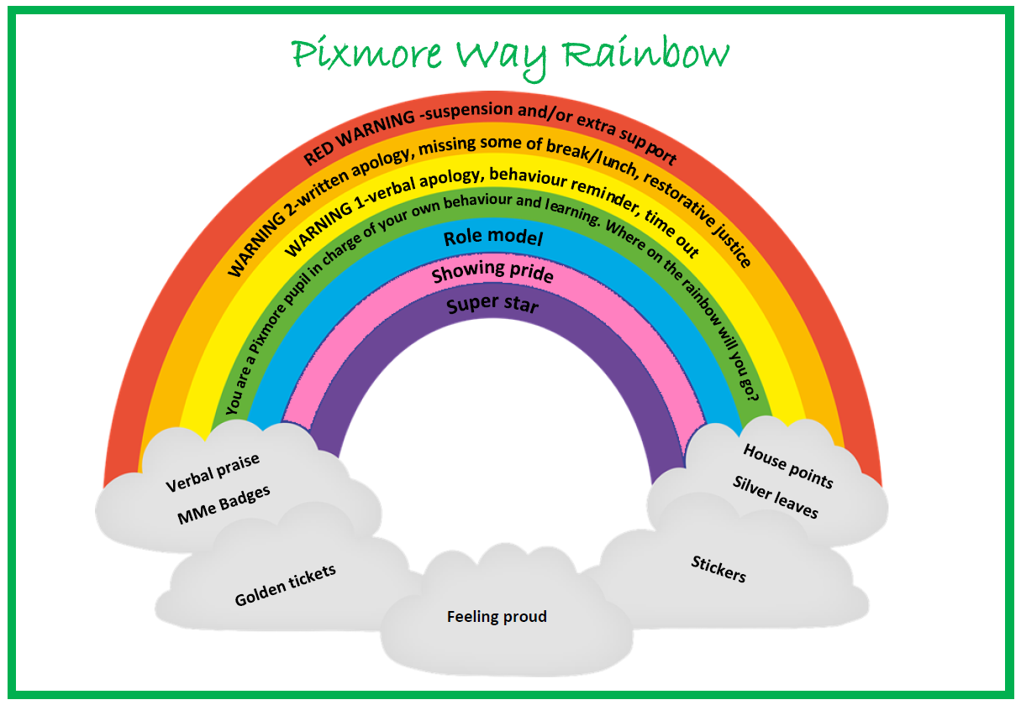
Sanctions
As well as wanting Pixmore to be a positive place where pupils are rewarded for the contribution they make, we also expect negative behaviour to be dealt with fairly, consistently and with compassion.
Bullying, racist and homophobic behaviour, and any behaviour designed to promote or incite radical views is not tolerated. When dealing with inappropriate behaviour staff should refer to the Pixmore Way behaviour ladder.
A large part of the Pixmore Way is helping pupils understand and reflect upon their emotions and behaviour therefore alongside the Pixmore Way we use restorative justice and Zones of Regulation.
In managing children’s behaviour in school, we also believe that there is a shared responsibility with parents and we expect staff to work alongside parents sharing both concerns and positives.
All staff need to read:
Behaviour for Learning policy
Antibullying policy
Refer to the full Pixmore Way for consequences of different behaviours.
CONTENTS

Slide 45
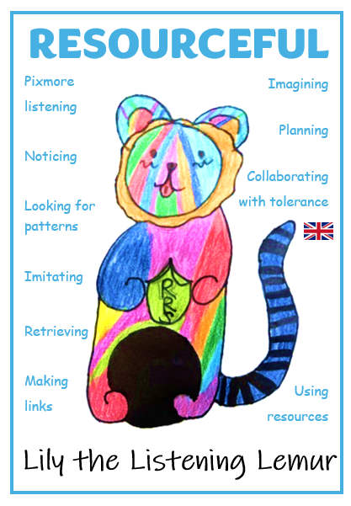

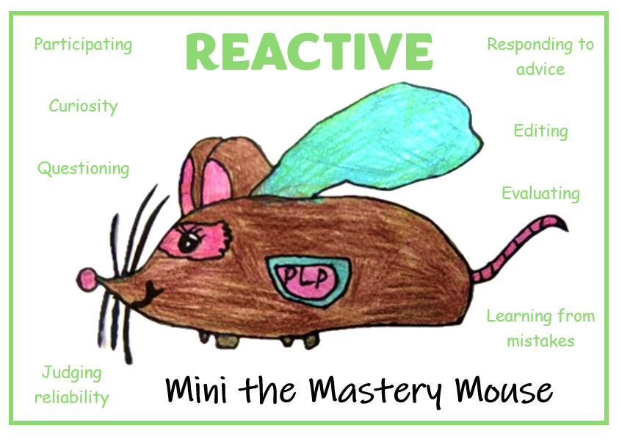
Pixmore Learning Power (PLP)
Pixmore Learning Power is based upon Guy Claxton’s Building Learning Power approach. It is a set of skills we have established as a school to support the development of a growth mindset which we believe is essential for being an effective learner.
BUILDING LEARNING POWER OVERVIEW VIDEO
We have developed 3 ‘super hero’ characters to help promote these skills. It is expected that all members of staff model, talk about and provide opportunities for pupils to develop these skills using these characters. This involves pupils showing they:
CONTENTS

Slide 46
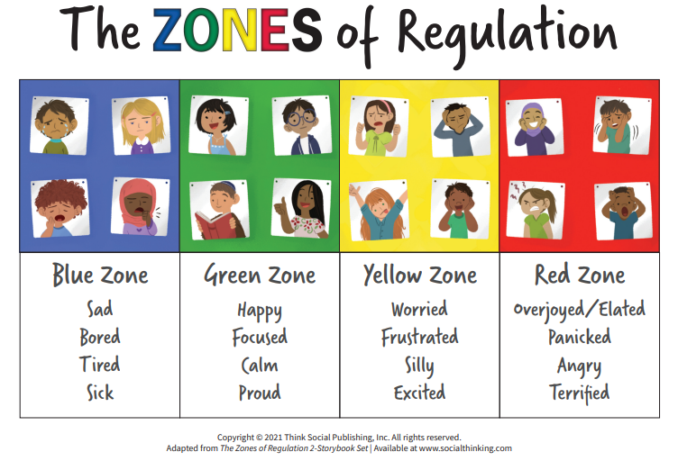
Zones of regulation
The Zones of Regulation is the original framework (Kuypers, 2011) that develops awareness of feelings, energy and alertness levels while exploring a variety of tools and strategies for regulation, prosocial skills, self-care, and overall wellness.
The 4 coloured ‘Zones’ provide an easy way to think and talk about feelings all of which are expected in life. Once pupils understand their feelings and zones, they can learn to use tools/strategies to manage feelings in different Zones.
Staff are expected to use the simple, common language and visual structure of The Zones of Regulation to help make the complex skill of regulation more concrete for learners.
ZONES OF REGULATION INTRODUCTION VIDEO
CONTENTS

